Slide 1
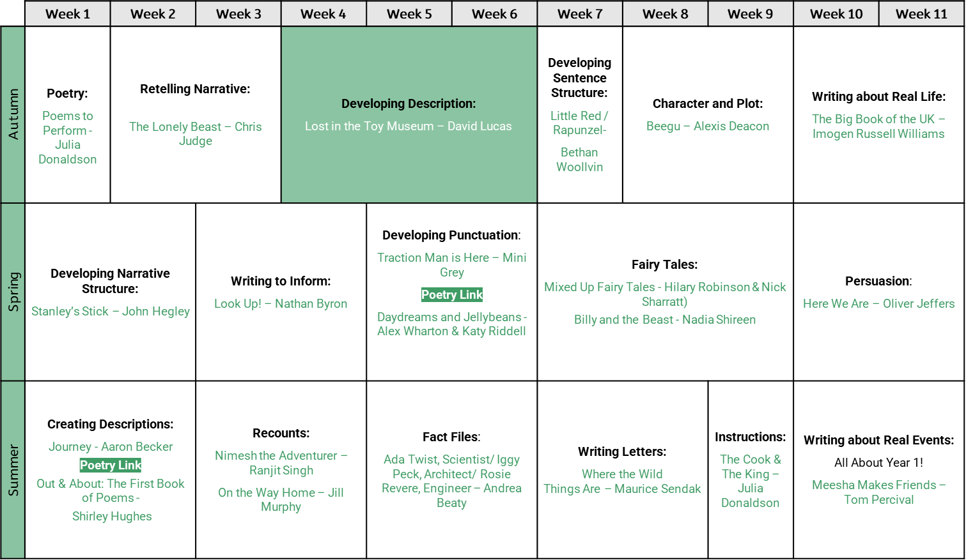
Year 1 writing unit and text overview

Slide 2
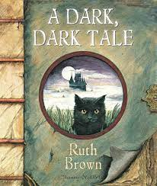
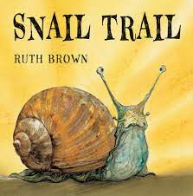
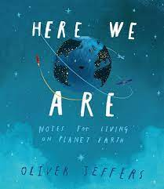
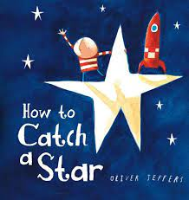
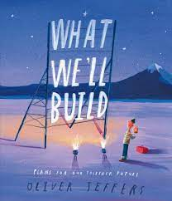
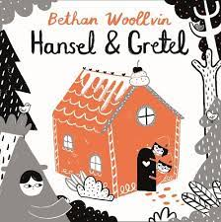
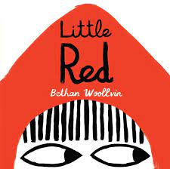
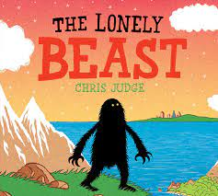
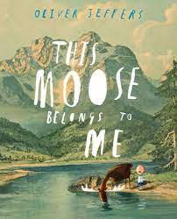
Year 1 Autumn Term 1 Class Read aloud | Year 1 Autumn Term 2 Class Read aloud

Slide 3
Year 1 Autumn Term 1 |  | Year 1 Autumn Term 2
Week 1 | Fiction – Lost and found by Oliver Jeffers | Week 1 | Fiction – A dark dark tale by Ruth Brown
 | Begin to link what they read or hear to their own experiences. Predict what might happen on the basis of what has been read so far. |  | Recognise and join in with predictable phrases. Explain clearly their understanding of what is read to them.
Week 2 | Fiction – How to catch a star by Oliver Jeffers | Week 2 | Fiction – Greyfriars Bobby by Ruth Brown
 | Make inferences on the basis of what is being said and done. Participate in discussion about what is read to them, taking turns and listening to what others say. |  | Check that the text makes sense to them as they read and correcting inaccurate reading. Discussing word meanings, linking new meanings to those already known.
Week 3 | Fiction- What we'll build by Oliver Jeffers | Week 3 | Fiction – Gracie the lighthouse cat by Ruth Brown
 | Make inferences on the basis of what is being said and done. Check that the text makes sense to them aa they read and correcting inaccurate reading. |  | Begin to link what they read or hear to their own experiences. Draw on what they already know or on background information and vocabulary provided by the teacher.
Week 4 | Fiction – The moose belongs to me by Oliver Jeffers | Week 4 | Fiction – Snail trail by Ruth Brown
 | Discuss the significance of the title and events. Predict what might happen on the basis of what is being said and done. |  | Discuss the significance of the title and events. Predict what might happen on the basis of what has been read so far.
Week 5 | Fiction – The heart and the bottle by Oliver Jeffers | Week 5 | Fiction – Rapunzel by Bethan Woolvin
 | Participate in discussion about what is read to them, taking turns and listening to what. Begin to link what they read or hear to their own experiences. |  | Listening to and discussing a wide range of poems, stories and non- fiction at a level beyond that at which they can read independently. Become very familiar with key stories, fairy stories and traditional tales, retelling them and considering their particular characteristics.
Week 6 | Fiction- Here we are by Oliver Jeffers | Week 6 | Fiction – Hansel and Gretel by Bethan Woolvin
 | Draw on what they already know or on background information and vocabulary provided by the teacher. Predict what might happen on the basis of what has been read so far. |  | Predict what might happen on the basis of what has been read so far. Participate in discussion about what is read to them, taking turns and listening to what others say.
Week 7 | Fiction- The Lonely Beast – Chris Judge | Week 7 | Fiction – Little Red by Bethan Woolvin
 | Recognise and join in with predictable phrases. Become very familiar with key stories, fairy stories and traditional tales, retelling them and considering their particular characteristics. |  | Draw on what they already know or on background information and vocabulary provided by the teacher. Make inferences on the basis of what is being said and done.
Week 8 | Poetry – Poems to perform by Julia Donaldson
 | Learning to appreciate rhymes and poems, and to recite some by heart. Explain clearly their understanding of what is read to them.

Slide 4
NNC Year 1 Reading Comprehension Through Book Talk Objectives Autumn
 | W1 | W2 | W3 | W4 | W5 | W6 | W7 | W8 | W9 | W10 | W11 | W12 | W13 | W14 | W15
Listening to and discussing a wide range of poems, stories and non-fiction at a level beyond that at which they can read independently | X |  |  |  |  |  |  |  |  |  |  |  | X
Begin to link what they read or hear to their own experiences | X |  |  |  | x |  |  |  |  |  | X
Become very familiar with key stories, fairy stories and traditional tales, retelling them and considering their particular characteristics |  |  |  |  |  |  | x |  |  |  |  |  | X
Recognise and join in with predictable phrases |  |  |  |  |  |  | x |  | X
Learning to appreciate rhymes and poems, and to recite some by heart |  |  |  |  |  |  |  | x
Discussing word meanings, linking new meanings to those already known |  |  |  |  |  |  |  |  |  | X
Draw on what they already know or on background information and vocabulary provided by the teacher |  |  |  |  |  | x |  |  |  |  | X |  |  |  | X
Check that the text makes sense to them as they read and correcting inaccurate reading |  |  | X |  |  |  |  |  |  | X
Discuss the significance of the title and events |  |  |  | X |  |  |  |  |  |  |  | X
Make inferences on the basis of what is being said and done |  | X | X |  |  |  |  |  |  |  |  |  |  |  | X
Predict what might happen on the basis of what has been read so far |  |  |  | x |  | X |  |  |  |  |  | X |  | X
Participate in discussion about what is read to them, taking turns and listening to what others say |  | X |  |  | x |  |  |  |  |  |  |  |  | X
Explain clearly their understanding of what is read to them |  |  |  |  |  |  |  | x | X

Slide 5
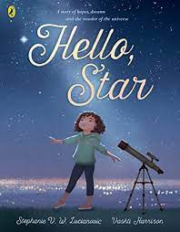
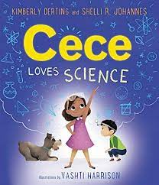
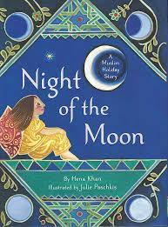
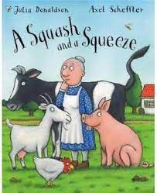
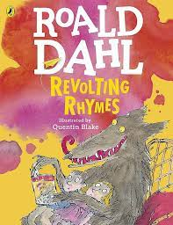
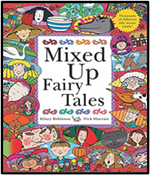
Year 1 Spring Term 1 Class Read aloud | Year 1 Spring Term 2 Class Read aloud

Slide 6
Year 1 Spring Term 1 |  | Year 1 Spring Term 2
Week 1 | Fiction – Hello star by Stephanie Lucianovic | Week 1 | Fiction – Night of the moon by Hena Khan
 | Draw on what they already know or on background information and vocabulary provided by the teacher Participate in discussion about what is read to them, taking turns and listening to what others say |  | Draw on what they already know or on background information and vocabulary provided by the teacher. Become very familiar with key stories, fairy stories, and traditional tales, retelling them and considering their particular characteristics.
Week 2 | Fiction- Cece loves science by Kimberley Derting | Week 2 | Fiction – Under my hijab by Hena Khan
 | Begin to link what they read or hear to their own experiences Make inferences on the basis of what is being said and done |  | Discuss the significance of the title and events. Predict what might happen on the basis of what is being said and done.
Week 3 | Non-fiction- Follow your dreams little one by Vashti Harrison | Week 3 | Poetry- Revolting rhymes by Roald Dahl
 | Listening to and discussing a wide range of poems, stories and non-fiction at a level beyond that at which they can read independently Discuss the significance of the title and events |  | Listening to and discussing a wide range of poems, stories and non-fiction at a level beyond that at which they can read independently. Learning to appreciate rhymes and poems, and to recite some by heart.
Week 4 | Fiction- Stanley's stick by John Hegley | Week 4 | Fiction- Mixed up fairy tales by Hilary Robinson
 | Discussing word meanings, linking new meanings to those already known Predict what might happen on the basis of what has been read so far |  | Become very familiar with key stories, fairy stories and traditional tales, retelling them and considering their particular characteristics. Discussing word meanings, linking new meanings to those already known.
Week 5 | Fiction – Look up by Nathan Byron | Week 5 | Fiction- Squash and a squeeze by Julia Donaldson
 | Participate in discussion about what is read to them, taking turns and listening to what others say Check that the text makes sense to them as they read and correcting innaccurate reading |  | Recognise and join in with predictable phrases. Make inferences on the basis of what is being said and done.

Slide 7
NNC Year 1 Reading Comprehension Through Book Talk Objectives SPRING
 | W1 | W2 | W3 | W4 | W5 | W6 | W7 | W8 | W9 | W10
Listening to and discussing a wide range of poems, stories and non-fiction at a level beyond that at which they can read independently |  |  | X |  |  |  |  | X
Begin to link what they read or hear to their own experiences |  | X
Become very familiar with key stories, fairy stories and traditional tales, retelling them and considering their particular characteristics |  |  |  |  |  | X |  |  | X
Recognise and join in with predictable phrases |  |  |  |  |  |  |  |  |  | X
Learning to appreciate rhymes and poems, and to recite some by heart |  |  |  |  |  |  |  | X
Discussing word meanings, linking new meanings to those already known |  |  |  | X |  |  |  |  | X
Draw on what they already know or on background information and vocabulary provided by the teacher | X |  |  |  |  | X
Check that the text makes sense to them as they read and correcting inaccurate reading |  |  |  |  | X
Discuss the significance of the title and events |  |  | X |  |  |  | X
Make inferences on the basis of what is being said and done |  | X |  |  |  |  |  |  |  | X
Predict what might happen on the basis of what has been read so far |  |  |  | X |  |  | X
Participate in discussion about what is read to them, taking turns and listening to what others say | X |  |  |  | X
Explain clearly their understanding of what is read to them

Slide 8
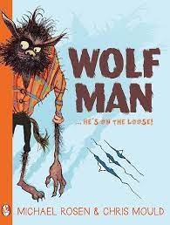
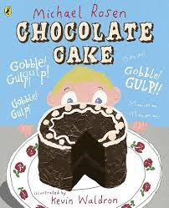
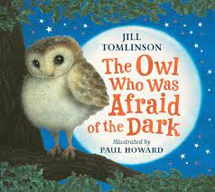
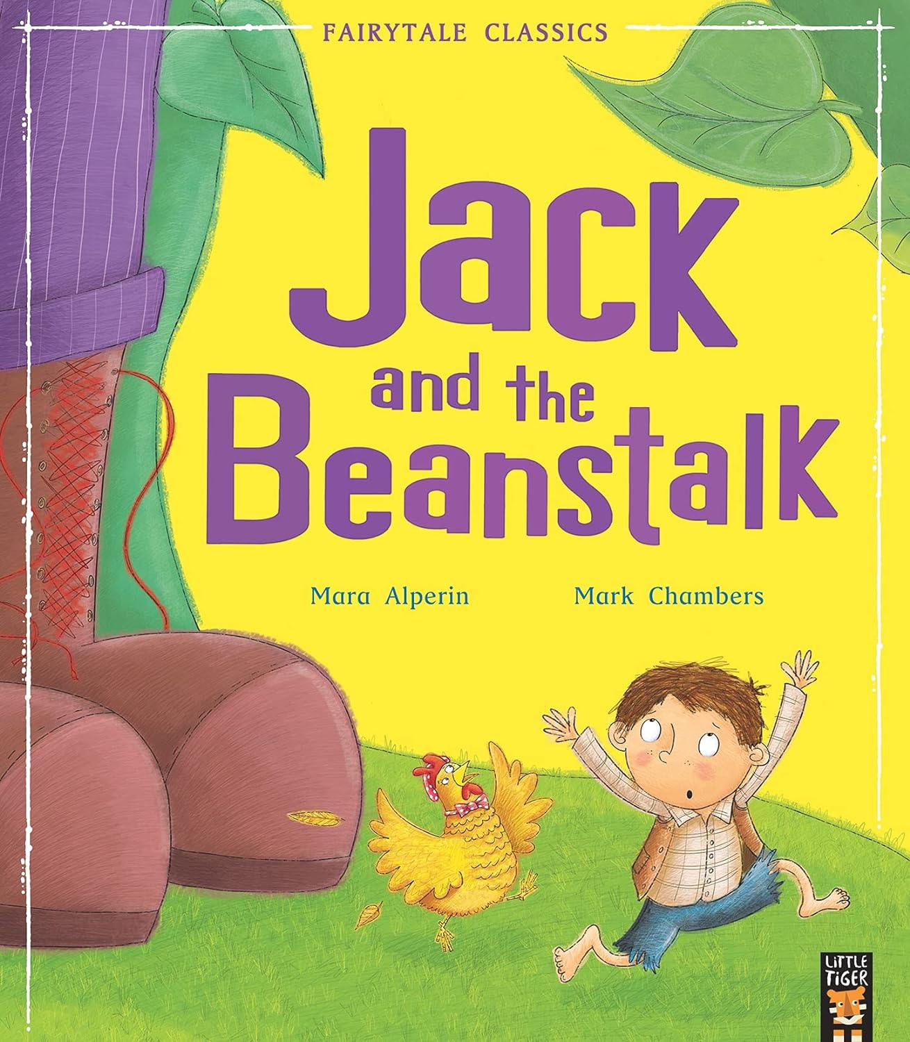
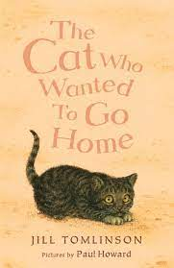
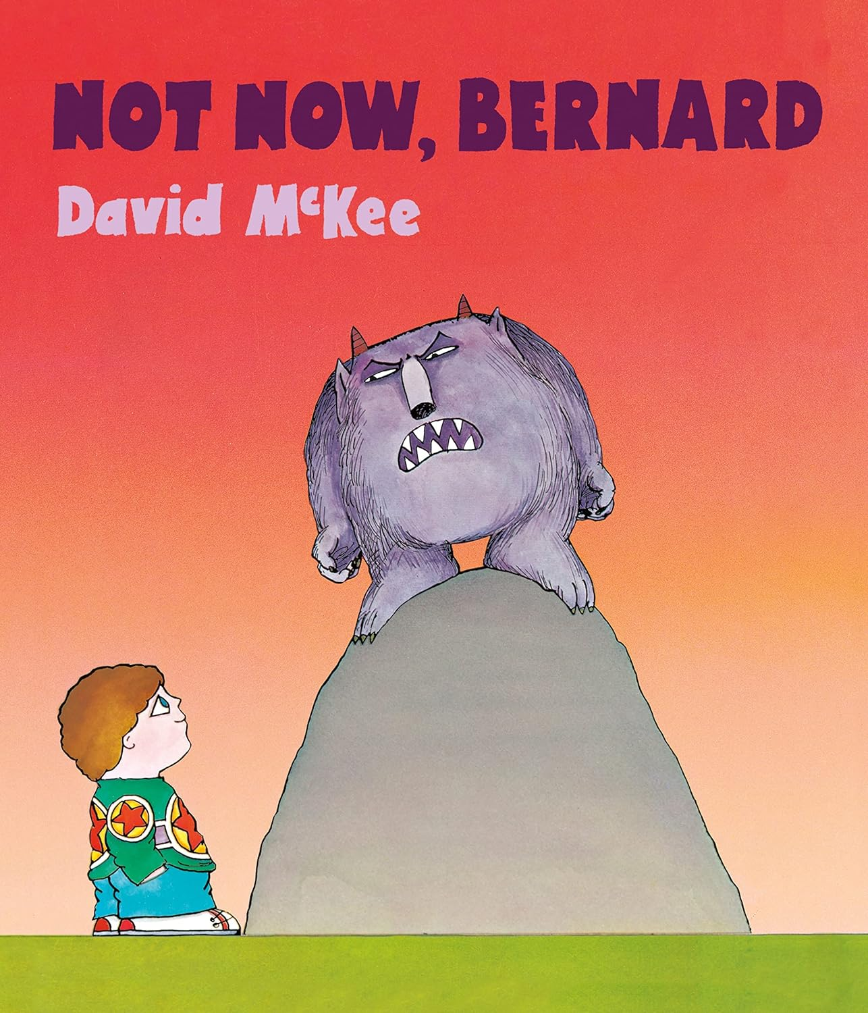
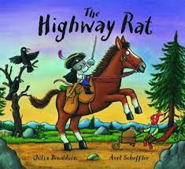
Year 1 Summer Term 1 Class Read aloud | Year 1 Summer Term 2 Class Read aloud

Slide 9
Year 1 Summer Term 1 |  | Year 1 Summer Term 2
Week 1 | Fiction- Were going on a bear hunt by Michael Rosen | Week 1 | Poetry Text- World at your feet by Rob Parker
 | Listening to and discussing a wide range of poems, stories and non-fiction at a level beyond that at which they can read independently. Recognise and join in with predictable phrases. |  | Listening to and discussing a wide range of poems, stories and non-fiction at a level beyond that at which they can read independently. Learning to appreciate rhymes and poems, and to recite some by heart.
Week 2 | Fiction- Wolf man by Michael Rosen | Week 2 | Fiction- The owl who was afraid of the dark by Jill Tomlinson
 | Discussing word meanings, linking new meanings to those already known. Make inferences on the basis of what is being said and done. |  | Discussing word meanings, linking new meanings to those already known. Make inferences on the basis of what is being said and done.
Week 3 | Poetry Text – Chocolate cake by Michael Rosen | Week 3 | Fiction- The three billy goats gruff by Kate Pankhurst and Mara Alperin
 | Listening to and discussing a wide range of poems, stories and non-fiction at a level beyond that at which they can read independently. Learning to appreciate rhymes and poems, and to recite some by heart. |  | Become very familiar with key stories, fairy stories and traditional tales, retelling them and considering particular characteristics. Recognise and join in with predictable phrases.
Week 4 | Non-Fiction – A planet full of plastic by Neal Layton | Week 4 | Fiction- The hen who wouldn't give up by Jill Tomlinson
 | Begin to link what they read or hear to their own experiences. Participate in discussion about what is read to them, taking turns and listening to what others say. |  | Check that the text makes sense to them as they read and correcting inaccurate reading. Participate in discussion about what is read to them, taking turns and listening to what others say,
Week 5 | Fiction- Highway rat by Julia Donaldson | Week 5 | Fiction- Jack and the Beanstalk by Mara Alperin and Mark Chambers
 | Recognise and join in with predictable phrases. Check that the text makes sense to them as they read and correcting inaccurate reading. |  | Become very familiar with key stories, fairy stories and traditional tales, retelling them and considering particular characteristics. Draw on what they already know or on background information and vocabulary provided by the teacher.
Week 6 | Fiction- Not now Bernard by David Mckee | Week 6 | Fiction- The cat who wanted to go home by Jill Tomlinson
 | Draw on what they already know or on background information and vocabulary provided by the teacher. Predict what might happen on the basis of what has been read so far. |  | Discuss the significance of the title and events. Predict what might happen on the basis of what has been read so far.
Week 7 | Non-fiction- Superhero like you by Dr Raj
 | Begin to link what they read or hear to their own experiences. Discuss the significance of the title and events.

Slide 10
NNC Year 1 Reading Comprehension Through Book Talk Objectives SUMMER
 | W1 | W2 | W3 | W4 | W5 | W6 | W7 | W8 | W9 | W10 | W11 | W12 | W13
Listening to and discussing a wide range of poems, stories and non-fiction at a level beyond that at which they can read independently | X |  | x |  |  |  |  | X
Begin to link what they read or hear read to their own experiences |  |  |  | X |  |  | X
Become very familiar with key stories, fairy stories and traditional tales, retelling them and considering their particular characteristics |  |  |  |  |  |  |  |  |  | X |  | X
Recognise and join in with predictable phrases | X |  |  |  | X |  |  |  |  | X
Learning to appreciate rhymes and poems, and to recite some by heart |  |  | X |  |  |  |  | X
Discussing word meanings, linking new meanings to those already known |  | X |  |  |  |  |  |  | X
Draw on what they already know or on background information and vocabulary provided by the teacher |  |  |  |  |  | X |  |  |  |  |  | X
Check that the text makes sense to them as they read and correcting inaccurate reading |  |  |  |  | X |  |  |  |  |  | x
Discuss the significance of the title and events |  |  |  |  |  |  | X |  |  |  |  |  | X
Make inferences on the basis of what is being said and done |  | x |  |  |  |  |  |  | X
Predict what might happen on the basis of what has been read so far |  |  |  |  |  | X |  |  |  |  |  |  | X
Participate in discussion about what is read to them, taking turns and listening to what others say |  |  |  | x |  |  |  |  |  |  | x
Explain clearly their understanding of what is read to them

Slide 11
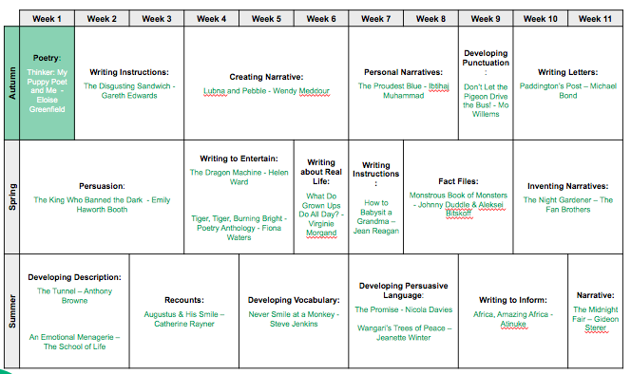
Year 2 writing unit and text overview

Slide 12
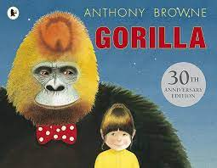
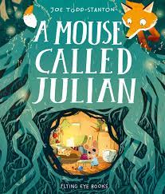
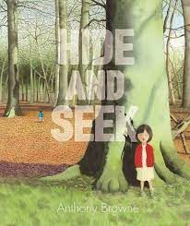
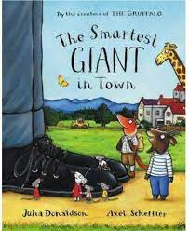
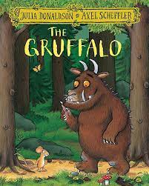
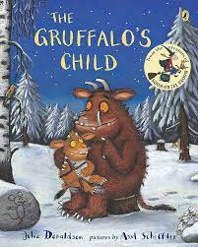
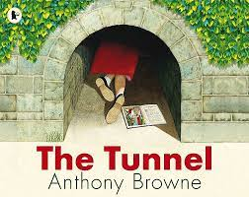
Year 2 Autumn Term 1 | Year 2 Autumn Term 2

Slide 13
Year 2 Autumn Term 1 |  | Year 2 Autumn Term 2
Week 1 | Fiction: A Mouse Called Julian | Week 1 | Fiction: The Grufallo
 | Answering & asking questions |  | Becoming increasingly familiar with & retelling a wider range of stories, fairy, stories and traditional tales
Week 2 | Fiction: Gorilla | Week 2 | Fiction: The Gruffalo's Child
 | Predicting what might happen based on what has been read so far |  | Draw on what they already know/ on background information & vocabulary provided by the teacher
Week 3 | Fiction: Hide & Seek | Week 3 | Fiction: The Dot
 | Discussing their favourite words & phrases |  | Discuss the sequence of events in books and how items of information are related. Checking that the text makes sense to them as they read and correcting inaccurate reading
Week 4 | Fiction: The Secret of Black Rock | Week 4 | Non-Fiction: Everest
 | Answering & asking questions |  | Being introduced to NF texts that are structured in different ways. Checking that the text makes sense to them as they read and correcting inaccurate reading
Week 5 | Fiction: The Tunnel | Week 5 | Fiction/Poetry: Poems To Perform
 | Making inferenced on the basis of what is being said & done |  | Listen to, discuss & express views about a wide range of contemporary & classis poetry, stories & non-fiction at a level beyond that at which their can read independently
Week 6 | Fiction: Smartest Giant in Town | Week 6 | Fiction/Poetry: I am Peace
 | Participate in discussion about books, poems & other words that are read to them & those they can read themselves, taking turns & listening to what others say |  | Explain & discuss their understanding of books, poems & other material, both that they listen to & those they read themselves

Slide 14
NNC Year 2 Reading Comprehension Through Book Talk and RWi Objectives Autumn
 | W1 | W2 | W3 | W4 | W5 | W6 | W7 | W8 | W9 | W10 | W11 | W12
Listen to, discuss & express views about a wide range of contemporary & classis poetry, stories & non-fiction at a level beyond that at which their can read independently |  |  |  |  |  |  |  |  |  |  | x
Discuss the sequence of events in books and how items of information are related |  |  |  |  |  |  |  |  | x
Becoming increasingly familiar with & retelling a wider range of stories, fairy, stories and traditional tales |  |  |  |  |  |  | x
Being introduced to NF texts that are structured in different ways |  |  |  |  |  |  |  |  |  | X
Recognising simple recurring literary language in stories & poetry
Discussing & clarifying the meanings of words, linking new meanings to known vocabulary
Discussing their favourite words & phrases |  |  | X
Continuing to build up a repertoire of poems learnt by heart, appreciating these & reciting some, with appropriate intonation to make the meaning clear
Draw on what they already know/ on background information & vocabulary provided by the teacher |  |  |  |  |  |  |  | x
Checking that the text makes sense to them as they read and correcting inaccurate reading |  |  |  |  |  |  |  |  | X | x
Making inferenced on the basis of what is being said & done |  |  |  |  | x
Answering & asking questions | X |  |  | x
Predicting what might happen based on what has been read so far |  | x
Participate in discussion about books, poems & other words that are read to them & those they can read themselves, taking turns & listening to what others say |  |  |  |  |  | x
Explain & discuss their understanding of books, poems & other material, both that they listen to & those they read themselves |  |  |  |  |  |  |  |  |  |  |  | x

Slide 15
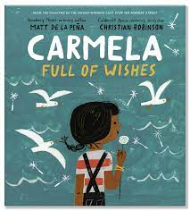
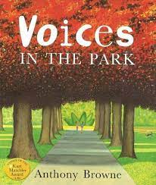
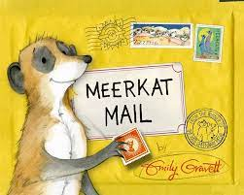
Year 2 Spring Term 1 | Year 2 Spring Term 2

Slide 16
Year 2 Spring Term 1 |  | Year 2 Spring Term 2
Week 1 | Non-Fiction: A Planet Full of Plastic | Week 1 | Poetry: Poems to Perform
 | Checking that the text makes sense to them as they read and correcting inaccurate reading |  | Continuing to build up a repertoire of poems learnt by heart, appreciating these & reciting some, with appropriate intonation to make the meaning clear.
Week 2 | Fiction: Meerkat Mail | Week 2 | Poetry Text: Poems to Perform
 | Making inferenced on the basis of what is being said & done. |  | Listen to, discuss & express views about a wide range of contemporary & classis poetry, stories & non-fiction at a level beyond that at which their can read independently
Week 3 | Fiction: Love | Week 3 | Fiction: The Lion Inside
 | Answering & asking questions. Discussing & clarifying the meanings of words, linking new meanings to known vocabulary |  | Discussing & clarifying the meanings of words, linking new meanings to known vocabulary. Discussing their favourite words / phrases.
Week 4 | Fiction: Last Stop on Market Street | Week 4 | Fiction: The Koala that Could
 | Discuss the sequence of events in books and how items of information are related |  | Becoming increasingly familiar with & retelling a wider range of stories, fairy, stories and traditional tales.
Week 5 | Fiction: Carmela Full Of Wishes | Week 5 | Fiction: The Worrysaurus
 | Predicting what might happen based on what has been read so far. |  | Participate in discussion about books, poems & other words that are read to them & those they can read themselves, taking turns & listening to what others say.
Week 6 | Fiction/Non-Fiction/Poetry Text: Milo Imagines the World | Week 6 | Fiction: Voices in the Park
 | Explain & discuss their understanding of books, poems & other material, both that they listen to & those they read themselves |  | Explain & discuss their understanding of books, poems & other material, both that they listen to & those they read themselves.

Slide 17
NNC Year 2 Reading Comprehension Objectives SPRING
 | W1 | W2 | W3 | W4 | W5 | W6 | W7 | W8 | W9 | W10 | W11 | W12
Listen to, discuss & express views about a wide range of contemporary & classis poetry, stories & non-fiction at a level beyond that at which their can read independently |  |  |  |  |  |  |  | X
Discuss the sequence of events in books and how items of information are related |  |  |  | x
Becoming increasingly familiar with & retelling a wider range of stories, fairy, stories and traditional tales |  |  |  |  |  |  |  |  |  | x
Being introduced to NF texts that are structured in different ways
Recognising simple recurring literary language in stories & poetry
Discussing & clarifying the meanings of words, linking new meanings to known vocabulary |  |  | x |  |  |  |  |  | X
Discussing their favourite words & phrases |  |  |  |  |  |  |  |  | X
Continuing to build up a repertoire of poems learnt by heart, appreciating these & reciting some, with appropriate intonation to make the meaning clear |  |  |  |  |  |  | X
Draw on what they already know/ on background information & vocabulary provided by the teacher
Checking that the text makes sense to them as they read and correcting inaccurate reading | X
Making inferenced on the basis of what is being said & done |  | x
Answering & asking questions |  |  | x
Predicting what might happen based on what has been read so far |  |  |  |  | x
Participate in discussion about books, poems & other words that are read to them & those they can read themselves, taking turns & listening to what others say |  |  |  |  |  |  |  |  |  |  | x
Explain & discuss their understanding of books, poems & other material, both that they listen to & those they read themselves |  |  |  |  |  | X |  |  |  |  |  | x

Slide 18
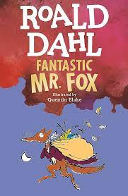
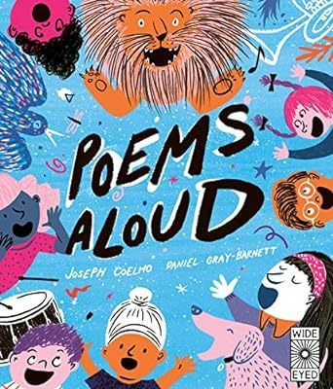
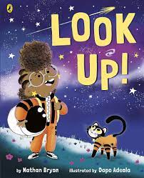
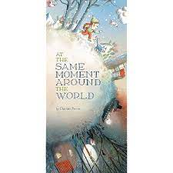
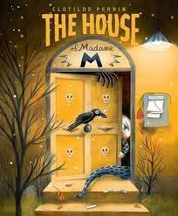
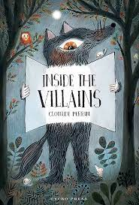
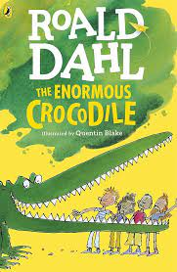
Year 2 Summer Term 1 Class read aloud | Year 2 Summer Term 2 Class read aloud

Slide 19
Year 2 Summer Term 1 |  | Year 2 Summer Term 2
Week 1 | Fiction: Perfectly Norman | Week 1 | Fiction: The House
 | Discussing & clarifying the meanings of words, linking new meanings to known vocabulary. |  | Discuss the sequence of events in books and how items of information are related
Week 2 | Fitcion: The Twits | Week 2 | Poetry: Poems Aloud
 | Discussing favourite words and phrases. |  | Continuing to build up a repertoire of poems learnt by heart, appreciating these & reciting some, with appropriate intonation to make the meaning clear
Week 3 | Fiction: The Twits | Week 3 | Fiction: Look Up!
 | Predicting what might happen based on what has been read so far |  | Answering & asking questions
Week 4 | Fiction: Fantastic Mr Fox | Week 4 | Fiction: Inside the Villains
 | Draw on what they already know/ on background information & vocabulary provided by the teacher |  | Becoming increasingly familiar with & retelling a wider range of stories, fairy, stories and traditional tales
Week 5 | Fiction: Ravi's Roar | Week 5 | Fiction: The Same Moment Around the World
 | Participate in discussion about books, poems & other words that are read to them & those they can read themselves, taking turns & listening to what others say. |  | Making inferenced on the basis of what is being said & done
Week 6 | Fiction: Clean Up | Week 6 | Fiction: The Enormous Crocodile
 | Explain & discuss their understanding of books, poems & other material, both that they listen to & those they read themselves |  | Checking that the text makes sense to them as they read and correcting inaccurate reading

Slide 20
NNC Year 2 Reading Comprehension Objectives SUMMER
 | W1 | W2 | W3 | W4 | W5 | W6 | W7 | W8 | W9 | W10 | W11 | W12
Listen to, discuss & express views about a wide range of contemporary & classis poetry, stories & non-fiction at a level beyond that at which their can read independently
Discuss the sequence of events in books and how items of information are related |  |  |  |  |  |  | X
Becoming increasingly familiar with & retelling a wider range of stories, fairy, stories and traditional tales |  |  |  |  |  |  |  |  |  | X
Being introduced to NF texts that are structured in different ways
Recognising simple recurring literary language in stories & poetry
Discussing & clarifying the meanings of words, linking new meanings to known vocabulary | X
Discussing their favourite words & phrases |  | X
Continuing to build up a repertoire of poems learnt by heart, appreciating these & reciting some, with appropriate intonation to make the meaning clear |  |  |  |  |  |  |  | X
Draw on what they already know/ on background information & vocabulary provided by the teacher |  |  |  | X
Checking that the text makes sense to them as they read and correcting inaccurate reading |  |  |  |  |  |  |  |  |  |  | X
Making inferenced on the basis of what is being said & done |  |  |  |  |  |  |  |  |  | X
Answering & asking questions |  |  |  |  |  |  |  |  | X
Predicting what might happen based on what has been read so far |  |  | X
Participate in discussion about books, poems & other words that are read to them & those they can read themselves, taking turns & listening to what others say |  |  |  |  | X
Explain & discuss their understanding of books, poems & other material, both that they listen to & those they read themselves |  |  |  |  |  | C

Slide 21
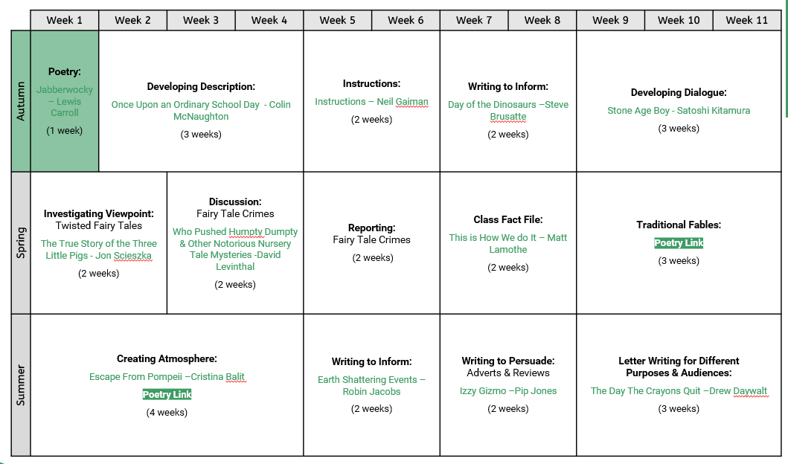
Year 3 writing unit and text overview

Slide 22
Weekly reading structure
Year 3 – 2 weekly cycle
Monday | Tuesday | Wednesday | Thursday | Friday
Vocabulary instruction (10 minutes daily – 365 words and etymology)
Fluency practice (30 mins) | Extended reading (30 mins) | Fluency practice (30 mins) | Extended reading (30 mins) | Close reading (30 mins)
Monday | Tuesday | Wednesday | Thursday | Friday
Vocabulary instruction (10 minutes daily – 365 words and etymology)
Fluency practice (30 mins) | Extended reading (30 mins) | Close reading (30 mins) | Skills (30 mins) | Skills (30 mins)

Slide 23
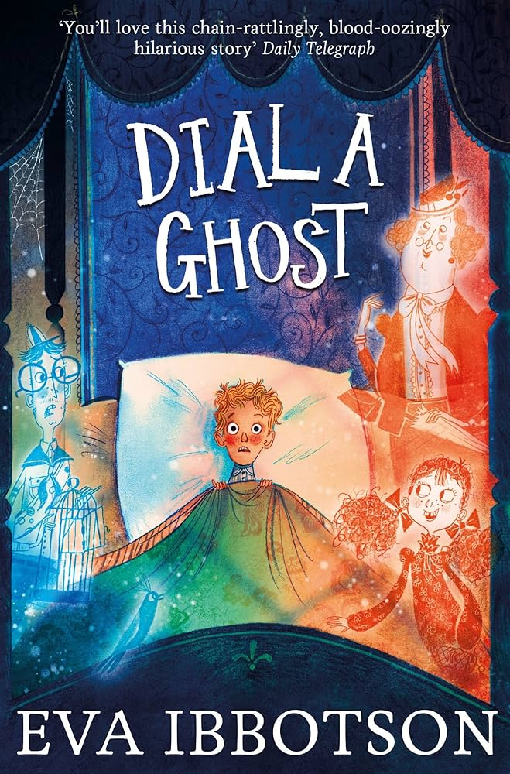
Year 3 Autumn Term 1 Class read aloud | Year 3 Autumn Term 2 Class read aloud
Planet Omar: Accidental Trouble Magnet. Zanib Mian. | Dial a Ghost. Eva Ibbotson.

Slide 24
Year 3 Autumn Term 1 |  | Year 3 Autumn Term 2
Week 1 | Poetry – Jabberwocky | Week 1 | Non-fiction - Day of the dinosaurs.
 | Monday -To prepare poems and play scripts to read aloud and to perform Tuesday -To retrieve and record Wednesday-To discuss words and phrases that capture the reader’s interest and imagination Thursday - To recognise some different forms of poetry Friday-To identify how language contributes to meaning |  | Monday- To identify how presentation contributes to meaning (e.g. certain words written in a different font/bold/italics for emphasis) Tuesday- To retrieve and record information from non-fiction Wednesday- To explain the meaning of words in context Thursday-skills Friday- skills
Week 2 | Narrative non-fiction - The pebble in my pocket. (Science link: rocks) | Week 2 | Fiction – smoot: a rebellious shadow/ the dark. (Science link)
 | Monday -To explain the meaning of words in context Tuesday -To summarise Wednesday -To identify how presentation contributes to meaning (e.g. certain words written in a different font/bold/italics for emphasis) Thursday - skills Friday- skills |  | Monday - To explain the meaning of words in context Tuesday To retell some books orally Wednesday -To identify how presentation contributes to meaning (e.g. certain words written in a different font/bold/italics for emphasis Thursday -identify themes in a wide range of books (ie the big messages of a text - e.g. friendship, courage) Friday - discuss words and phrases that capture the reader’s interest and imagination
Week 3 | Fiction- Planet Omar | Week 3 | Fiction – Stone Age Boy (History link)
 | Monday - To identify how structure contributes to meaning Tuesday- To identify main ideas drawn from more than 1 paragraph and summarising these. Wednesday- To identify how presentation contributes to meaning (e.g. certain words written in a different font/bold/italics for emphasis. Thursday-To retell some books orally Friday- To draw inferences and justify them with evidence |  | Monday - To explain the meaning of words in context Tuesday - To identify themes in a wide range of books Wednesday - To retell some books orally Thursday - skills Friday - skills
Week 4 | Non-fiction- Pablo Picasso - (Art link) Little people big dreams | Week 4 | Picture book – The spaces in between – Jaspreet Kaur (Empathy)
 | Monday - To identify main ideas drawn from more than 1 paragraph and summarising these Tuesday-To identify conventions in a wide range of books Wednesday- To retrieve information from non-fiction Thursday - skills Friday – skills |  | Monday – Identify how presentation contributes to meaning Tuesday – identify conventions across a wide range of books Wednesday- discuss words and phrases that capture the reader’s interest and imagination Thursday- identify themes in a wide range of books (ie the big messages of a text - e.g. friendship, courage) Friday-- To draw inferences about character feelings
Week 5 | Fiction - Beneath - Cori Doerrfeld (Empathy) | Week 5 | Poetry – Roald Dahl's revolting rhymes
 | Monday –To predict what might happen from details stated and implied Tuesday- To identify themes in a wide range of books Wednesday-To identify how structure contributes to meaning Thursday-To identify main ideas drawn from more than 1 paragraph and summarising these Friday- To draw inferences about character feelings |  | Monday - To read poems aloud Tuesday - Retrieve and record information non-fiction Wednesday- Prepare poems and play scripts to read aloud and to perform Thursday -skills Friday -skills
Week 6 | Fiction - 'Instructions' by Neil Gaiman (Writing unit text) | Week 6 | Non-fiction – Stonehenge (History)
 | Monday - To identify how structure contributes to meaning Tuesday - To identify main ideas drawn from more than 1 paragraph and summarising these Wednesday - To prepare poems and play scripts to read aloud and to perform Thursday – skills Friday – skills |  | Monday - To identify how structure contributes to meaning Tuesday - To identify main ideas drawn from more than 1 paragraph and summarising these (Tuesday). Wednesday- To explain the meaning of words in context (Wednesday). Thursday –To identify main ideas drawn from more than 1 paragraph and summarising these Friday- identify how language contributes to meaning
Week 7 | Poetry- The Sound Collector by Roger McGough The Owl and the Pussycat by Edward Lear Matilda Who Told Lies And Was Burned To Death by Hillaire Belloc (Reading booth) | Week 7 | Fiction- Stone age tales - Terry Dreary Stone Age Tales: The Great Storm - Terry Deary - Google Books
 | Monday- To prepare poems and play scripts to read aloud and to perform Tuesday--identify main ideas drawn from more than 1 paragraph and summarising these Wednesday-To identify how structure contributes to meaning Thursday-To recognise some different forms of poetry Friday-To identify how language contributes to meaning |  | Monday- To prepare poems and play scripts to read aloud and to perform Tuesday - To recognise some different forms of poetry (Tues) Wednesday - To identify how structure contributes to meaning (Wed) Thursday - skills Friday- skills
Week 8 | Fiction - Town is by the sea (Geography – mining)
 | Monday- To identify how presentation contributes to meaning Tuesday-To identify themes in a wide range of books Wednesday- To identify main ideas drawn from more than 1 paragraph and summarising these Thursday-skills Friday-skills

Slide 25
NNC YEAR 3 Reading Comprehension Objectives AUTUMN
 | W1 | W2 | W3 | W4 | W5 | W6 | W7 | W8 | W9 | W10 | W11 | W12 | W13 | W14
*use dictionaries to check the meaning of words that they have read if they are unsure – close reading |  |  |  |  | x |  |  |  | x
*increase their familiarity with a wide range of books, including fairy stories, myths and legends – extended reading and over a longer period
*Retell some books orally – extended reading |  |  |  |  |  |  |  | x |  |  |  | x
*identify themes in a wide range of books (ie the big messages of a text - e.g. friendship, courage) extended reading and over a longer period |  |  |  |  |  | x |  |  |  |  |  | x
*identify conventions in a wide range of books (ie key features of a particular author or genre)extended reading and over a longer period |  |  |  |  |  |  |  |  | x
*prepare poems and play scripts to read aloud and to perform – fluency | X |  |  |  |  | x |  |  |  | x
*discuss words and phrases that capture the reader’s interest and imagination- close reading |  |  |  |  |  |  | x
*recognise some different forms of poetry - extended reading and over a longer period
*explain the meaning of words in context – fluency and close reading |  |  |  |  |  | x | x |  |  | x |  | x | x
*draw inferences (such as inferring characters' feelings, thoughts and motives from their actions) and justify inferences with evidence ("I think....because....") - close reading |  |  | x
*predict what might happen from details stated and implied – close and extended |  | X |  |  |  |  |  |  |  | x
*identify main ideas drawn from more than 1 paragraph and summarising these – extended |  |  |  | x |  | x | x |  |  |  |  |  | x
*identify how language contributes to meaning (e.g use of figurative language, precise and visual words) - close reading |  |  |  |  |  | x |  | x |  |  |  |  | x
*identify how structure contributes to meaning (e.g. use of different sentence lengths to build excitement or suspense) fluency |  |  |  |  | x |  |  | x |  |  |  |  | x
*identify how presentation contributes to meaning (e.g. certain words written in a different font/bold/italics for emphasis) fluency |  |  |  | x | x |  | x | x | x
* retrieve and record information from non-fiction extended reading | x |  |  |  | x |  |  |  | x | x |  | x | x

Slide 26
Year 3 Spring Term 1 | Year 3 Spring Term 2
The Invisible Boy. Patrice Barton. | The Bad Guys. Aaron Blabey.

Slide 27
Year 3 Spring Term 1 |  | Year 3 Spring Term 2
Week 1 | Fiction- True story of the 3 little pigs | Week 1 | Poetry– Nonsense poetry – Edward Lear https://www.nonsenselit.org/Lear/BoN/bon010.html
 | Monday - To identify how presentation contributes to meaning Tuesday - To retell some books orally Wednesday - To identify how structure contributes to meaning Thursday - To identify conventions in a wide range of books Friday- To discuss words and phrases that capture the reader’s interest and imagination |  | Monday - To prepare poems and play scripts to read aloud and to perform Tuesday- To identify themes Wednesday- To recognise some different forms of poetry Thursday-To identify conventions in a wide range of poetry Friday- To draw inferences
Week 2 | Non-fiction - Broken bones, Bone health in children | Week 2 | Non-fiction– National Geographic –Ancient Egypt
 | Monday - To explain the meaning of words in context Tuesday - To retrieve and record information from non-fiction Wednesday- To identify how structure contributes to meaning Thursday - skills Friday- skills |  | Monday-To identify how presentation contributes to meaning Tuesday- To retrieve and record information from non-fiction Wednesday-To identify how structure contributes to meaning Thursday-skills Friday-skills
Week 3 | Fiction –Usborne classics Grimm's Fairy tales | Week 3 | Non-fiction – why are tomatoes a fruit? (Science link)
 | Monday - To predict what might happen from details stated and implied Tuesday - To retell some books orally Wednesday- To identify how presentation contributes to meaning Thursday- To identify conventions in a wide range of books Friday - To discuss words and phrases that capture the reader’s interest and imagination |  | Monday- To explain the meaning of words in context Tuesday- To retrieve and record information from non-fiction Wednesday-To identify how presentation and structure contributes to meaning Thursday- To identify conventions Friday - To discuss words and phrases that capture the reader’s interest and imagination
Week 4 | Poetry - The magic box, From A Railway Carriage by Robert Louis Stevenson | Week 4 | Playscript–Aesop's fables playscript - The wolf and the lamb, The lion and the mouse https://www.lazybeescripts.co.uk/Scripts/Script.aspx?iSS=413
 | Monday - To prepare poems and play scripts to read aloud and to perform Tuesday- To identify themes Wednesday- To recognise some different forms of poetry Thursday- skills Friday- skills |  | Monday-To perform a playscript Tuesday-To identify conventions of play scripts Wednesday-To identify how structure contributes to meaning Thursday-skills Friday- skills
Week 5 | Non-fiction - Humpty Dumpty news report | Week 5 | Non –fiction - A child like you – Naima B Robert (empathy)
 | Monday- To explain the meaning of words in context Tuesday- To retrieve and record information from non-fiction Wednesday- To identify how presentation and structure contributes to meaning Thursday- To identify conventions Friday- To identify how language contributes to meaning |  | Monday –To predict what might happen from details stated and implied Tuesday- To identify themes in a wide range of books Wednesday-To identify how structure contributes to meaning Thursday-To identify main ideas drawn from more than 1 paragraph and summarising these Friday- To draw inferences

Slide 28
NNC YEAR 3 Reading Comprehension Objectives SPRING
 | W1 | W2 | W3 | W4 | W5 | W6 | W7 | W8 | W9 | W10
*use dictionaries to check the meaning of words that they have read if they are unsure |  |  |  |  |  |  | x
*increase their familiarity with a wide range of books, including fairy stories, myths and legends |  |  |  |  |  |  | x
*Retell some books orally | x |  | x |  |  |  |  |  | x
*identify themes in a wide range of books (ie the big messages of a text - e.g. friendship, courage) |  |  |  | x
*identify conventions in a wide range of books (ie key features of a particular author or genre) | x | x | x |  | x | x |  | x | x
*prepare poems and play scripts to read aloud and to perform |  |  |  | x
*discuss words and phrases that capture the reader’s interest and imagination | x |  | x | x |  |  | x |  |  | x
*recognise some different forms of poetry |  |  |  | x
*explain the meaning of words in context |  | x |  |  | x |  | x | x | x | x
*draw inferences (such as inferring characters' feelings, thoughts and motives from their actions) and justify inferences with evidence ("I think....because....") |  |  |  |  |  |  |  |  | x
*predict what might happen from details stated and implied |  |  | x
*identify main ideas drawn from more than 1 paragraph and summarising these |  |  |  |  |  | x |  |  |  | x
*identify how language contributes to meaning (e.g use of figurative language, precise and visual words) |  |  |  |  | x |  | x |  |  | x
*identify how structure contributes to meaning (e.g. use of different sentence lengths to build excitement or suspense) | x | x | x |  | x | x | x | x | x | x
*identify how presentation contributes to meaning (e.g. certain words written in a different font/bold/italics for emphasis) | x |  | x |  | x | x |  | x
* retrieve and record information from non-fiction |  | x |  |  | x |  |  | x

Slide 29
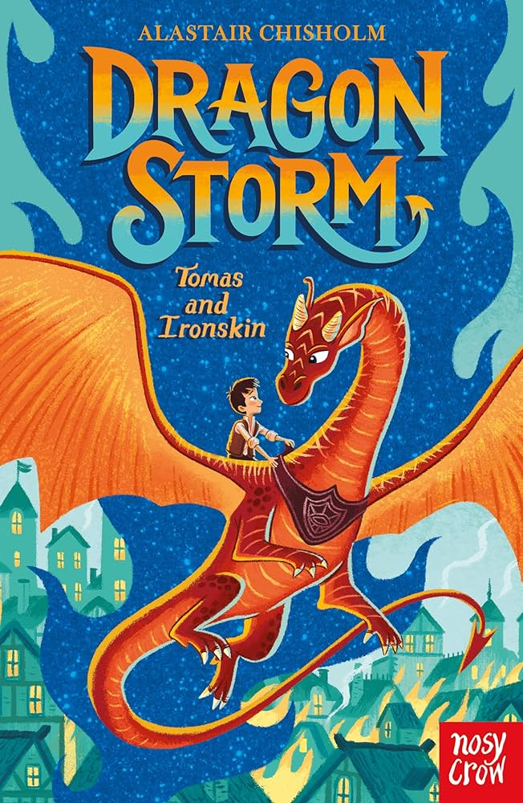
Year 3 Summer Term 1 | Year 3 Summer Term 2
The Tin Forest. Helen Ward. | Dragon Storm. Alastair Chisholm.

Slide 30
NNC YEAR 3 Reading Comprehension Objectives SUMMER
 | W1 | W2 | W3 | W4 | W5 | W6 | W7 | W8 | W9 | W10 | W11 | W12 | W13
*use dictionaries to check the meaning of words that they have read if they are unsure | x
*increase their familiarity with a wide range of books, including fairy stories, myths and legends
*Retell some books orally | x |  | x |  |  |  |  | x |  | x
*identify themes in a wide range of books (ie the big messages of a text - e.g. friendship, courage) |  |  | x | x | x |  | x |  |  |  | x | x
*identify conventions in a wide range of books (ie key features of a particular author or genre) |  |  |  |  |  |  |  |  |  |  | x |  | x
*prepare poems and play scripts to read aloud and to perform
*discuss words and phrases that capture the reader’s interest and imagination |  |  |  |  |  |  |  |  |  |  |  | x
*recognise some different forms of poetry
*explain the meaning of words in context |  | x | x | x | x | x |  | x | x | x | x | x | x
*draw inferences (such as inferring characters' feelings, thoughts and motives from their actions) and justify inferences with evidence ("I think....because....") | x |  |  |  |  |  | x
*predict what might happen from details stated and implied
*identify main ideas drawn from more than 1 paragraph and summarising these | x | x |  |  |  | x | x | x | x | x |  | x | x
*identify how language contributes to meaning (e.g use of figurative language, precise and visual words) |  |  | x | x | x |  |  |  | x
*identify how structure contributes to meaning (e.g. use of different sentence lengths to build excitement or suspense) |  | x | x |  | x | x | x |  | x | x |  |  | x
*identify how presentation contributes to meaning (e.g. certain words written in a different font/bold/italics for emphasis) | x |  |  |  |  |  | x | x |  | x
* retrieve and record information from non-fiction |  | x |  | x | x | x |  |  | x

Slide 31
Year 3 Summer Term 1 |  | Year 3 Summer Term 2
Week 1 | Fiction - Escape from Pompeii | Week 1 | Fiction - The wild robot by Peter Brown
 | Monday -To use dictionaries to check the meaning of words that they have read if they are unsure Tuesday -To identify main ideas drawn from more than 1 paragraph and summarising these Wednesday- To identify how presentation and structure contributes to meaning Thursday -Retell some books orally Friday- draw inferences |  | Monday -To use dictionaries to check the meaning of words that they have read if they are unsure Tuesday -To identify main ideas drawn from more than 1 paragraph and summarising these Wednesday- To identify how presentation and structure contributes to meaning Thursday -skills Friday- skills
Week 2 | Non-Fiction – Sir Isaac Newton and the Apple Story. (Science link) | Week 2 | Non-Fiction –The role of women in Ancient Greece. Non-Fiction – The Hairy Bikers Moussaka (recipe)
 | Monday-To explain the meaning of words in context Tuesday-To retrieve and record information from non-fiction Wednesday- To identify how structure contributes to meaning lengths to build excitement or suspense) Thursday - skills Friday- skills |  | Monday- To explain the meaning of words in context Tuesday- To identify main ideas drawn from more than 1 paragraph and summarising these Wednesday- To identify how structure contributes to meaning Thursday- Friday-
Week 3 | Fiction- The Muslims by Zanib Mian (R.E link) | Week 3 | Fiction – Orchard book of Greek myths
 | Monday - To identify how presentation contributes to meaning Tuesday- To identify themes Wednesday- To identify how structure contributes to meaning Thursday-To identify conventions in a wide range of poetry Friday- To draw inferences |  | Monday- To explain the meaning of words in context Tuesday- To retell some books orally Wednesday- To identify how structure contributes to meaning Thursday- To identify main ideas drawn from more than 1 paragraph Friday- To discuss words and phrases that capture the reader’s interest and imagination
Week 4 | Poetry- Walking With My Iguana by Brian Moses Be Glad Your Nose Is On Your Face by Jack Prelutsky | Week 4 | Playscript – Theseus and the minotaur https://www.lazybeescripts.co.uk/Scripts/script.aspx?iSS=467
 | Monday - To prepare poems and play scripts to read aloud and to perform Tuesday- To identify themes Wednesday- To recognise some different forms of poetry Thursday-skills Friday - skills |  | Monday-To perform a playscript Tuesday-To identify conventions of play scripts Wednesday-To identify how structure contributes to meaning Thursday-skills Friday- skills
Week 5 | Non-fiction - Earth shattering events. | Week 5 | Fiction – The Day the Crayons Quit.
 | To explain the meaning of words in context (Monday). To retrieve and record information from non-fiction (Tuesday) To identify how structure contributes to meaning (Wednesday). To identify themes in a wide range of books (Thursday). To identify how language contributes to meaning (Friday). |  | Monday- To identify how presentation contributes to meaning Tuesday- To identify themes in a wide range of books Wednesday- To explain the meaning of words in context Thursday- To identify made ideas drawn from more than 1 paragraph and summarise Friday- To discuss words and phrases that capture the readers interest and imagination
Week 6 | Fiction – The tear thief – Carol Anne Duffy | Week 6 | Fiction – I will swim next time – Emily Joof
 | Monday - To predict what might happen from details stated and implied Tuesday - To retell some books orally Wednesday- To identify how presentation contributes to meaning Thursday- skills Friday - skills |  | Monday –To predict what might happen from details stated and implied Tuesday- To identify themes in a wide range of books Wednesday-To identify how structure contributes to meaning Thursday-To identify main ideas drawn from more than 1 paragraph and summarising these Friday- To draw inferences
Week 7 | Fiction – Fortunately, the milk (Neil Gaiman)
 | Monday -To use dictionaries to check the meaning of words that they have read if they are unsure Tuesday -To identify main ideas drawn from more than 1 paragraph and summarising these Wednesday- To identify how presentation and structure contributes to meaning Thursday -Retell some books orally Friday- draw inferences

Slide 32
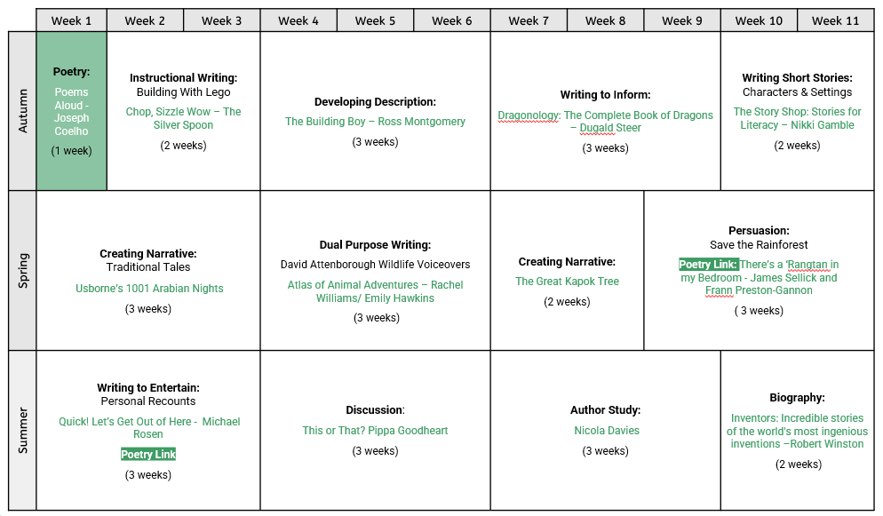
Year 4 writing unit and text overview

Slide 33
Weekly reading structure
Year 4 – 2 weekly cycle
Monday | Tuesday | Wednesday | Thursday | Friday
Vocabulary instruction (10 minutes daily – 365 words and etymology)
Fluency (30 mins) | Extended reading (30 mins) | Fluency (30 mins) | Extended reading (30 mins) | Close reading (30 mins)
Monday | Tuesday | Wednesday | Thursday | Friday
Vocabulary instruction (10 minutes daily – 365 words and etymology)
Fluency (30 mins) | Extended reading (30 mins) | Close reading (30 mins) | Skills (30 mins) | Skills (30 mins)

Slide 34
Year 4 Autumn Term 1 Class read aloud | Year 4 Autumn Term 2 Class read aloud
Joseph Coelho - Zombierella | Vashti Hardy - Crowfall

Slide 35
NNC YEAR 4 Reading Comprehension Objectives AUTUMN
 | W1 | W2 | W3 | W4 | W5 | W6 | W7 | W8 | W1 | W2 | W3 | W4 | W5 | W6 | W7
*use dictionaries to check the meaning of words that they have read if they are unsure – close reading |  |  |  |  |  |  |  |  |  | x
*increase their familiarity with a wide range of books, including fairy stories, myths and legends – extended reading | x |  | x | x | x |  |  |  | x | x | x | x |  | x | x
*Retell some books orally – extended reading over time |  |  |  |  | x |  |  |  |  |  | x | x |  |  | x
*identify themes in a wide range of books (ie the big messages of a text - e.g. friendship, courage) - extended reading |  |  |  |  | x | x | x | x |  |  |  | x
*identify conventions in a wide range of books (ie key features of a particular author or genre) - extended reading |  |  |  |  |  |  | x |  |  | x
*prepare poems and play scripts to read aloud and to perform -fluency | x | x |  |  |  |  |  |  |  |  | x |  |  |  | x
*discuss words and phrases that capture the reader’s interest and imagination – close reading | x | x | x |  |  |  | x
*recognise some different forms of poetry – extended reading over time | x | x
*explain the meaning of words in context – close reading |  |  | x |  |  |  |  |  | x |  |  |  | x
*draw inferences (such as inferring characters' feelings, thoughts and motives from their actions) and justify inferences with evidence ("I think....because....") - close reading |  |  | x | x | x |  |  | x |  |  |  | x |  | x
*predict what might happen from details stated and implied – close and extended |  |  |  | x |  |  |  | x |  |  |  |  |  | x
*identify main ideas drawn from more than 1 paragraph and summarising these - extended |  |  |  |  |  | x |  |  | x |  |  |  | x
*identify how language contributes to meaning (e.g use of figurative language, precise and visual words) - close reading |  | x |  | x |  |  |  |  |  |  |  |  |  | x
*identify how structure contributes to meaning (e.g. use of different sentence lengths to build excitement or suspense) - fluency | x | x |  | x |  | x |  | x | x | x | x |  | x | x | x
*identify how presentation contributes to meaning (e.g. certain words written in a different font/bold/italics for emphasis) - fluency |  |  |  |  | x | x | x | x | x |  |  | x | xx
* retrieve and record information from non-fiction – close and extended (dependent on extract length) |  |  |  |  |  |  |  |  |  | x

Slide 36
Year 4 Autumn Term 1 |  | Year 4 Autumn Term 2
Week 1 | Poetry Poems Aloud-Joseph Coelho (Writing unit text) |  | Fiction Dragonology: The Complete Book of Dragons – Dugald Steer (literacy unit text)
 | Monday-prepare poems and play scripts to read aloud and to perform Tuesday-recognise some different forms of poetry Wednesday-identify how structure contributes to meaning Thursday- identify conventions across a range of poems Friday- discuss words and phrases that capture the reader’s interest and imagination |  | Key Los Monday –Explain the meanings of words in context Tuesday- identify conventions Wednesday-identify how presentation contributes to meaning Thursday- skills Friday-skills
Week 2 | Non-Fiction -Brazil https://kids.nationalgeograhic.com/geography/countries/article/brazil |  | Non-Fiction Remembrance: What is it and why is it important? - BBC Newsround
 | Monday- To explain the meaning of words in context Tuesday- To retrieve and record information from non-fiction Wednesday-To identify how structure contributes to meaning Thursday – skills Friday – skills |  | Monday--identify meanings of words in context Tuesday-identify conventions Wednesday- identify how presentation contributes to meaning Thursday- retrieve information from non-fiction Friday-draw inferences (such as inferring characters' feelings, thoughts and motives from their actions) and justify inferences with evidence ("I think....because....")
Week 3 | Fiction- Roald Dahl's Revolting recipes |  | Poetry Dentist Dan - Shel Silverstein and The Toothless Wonder - Phil Bolsta (reading booth)
 | Monday -To use dictionaries to check the meaning of words Tuesday -To identify conventions Wednesday- To identify how presentation and structure contributes to meaning Thursday –To retell orally Friday- To discuss words and phrases that capture the reader's interest |  | Monday-prepare poems and play scripts to read aloud and to perform Tuesday-Retell some books orally Wednesday-draw inferences Thursday-skills Friday-skills
Week 4 | Fiction The girl who stole an elephant – Nizrana Farook (reading booth) |  | Fiction The Story Shop: Stories for Literacy – Nikki Gamble
 | Monday - identify how structure contributes to meaning Tuesday – retell orally Wednesday-predict what might happen from details stated and implied Thursday – skills Friday - skills |  | Monday-identify how structure contributes to meaning Tuesday-retell some books orally Wednesday-identify how presentation contributes to meaning Thursday-identify themes in a wide range of books Friday-draw inferences and justify inferences with evidence
Week 5 | Fiction My baba's garden – Jordan Scott (empathy) Kid normal – Greg James |  | Non-Fiction-Ancient Maya
 | Monday –To predict what might happen from details stated and implied Tuesday- To identify themes in a wide range of books Wednesday-To identify how structure contributes to meaning Thursday-To identify main ideas drawn from more than 1 paragraph and summarising these Friday- To draw inferences about character feelings
 | Key Los -increase their familiarity with a wide range of books, including fairy stories, myths and legends -identify how presentation contributes to meaning (e.g. certain words written in a different font/bold/italics for emphasis) -retell some books orally -draw inferences (such as inferring characters' feelings, thoughts and motives from their actions) and justify inferences with evidence ("I think....because....") -draw inferences and justify inferences with evidence |  | Monday-To identify how presentation contributes to meaning Tuesday-Retrieve and record information from non-fiction Wednesday- To explain the meaning of words in context Thursday-skills Friday-skills
Week 6 | Non – Fiction (Notable People) Plato (R.E link) https://kids.kiddle.co/Plato Yayoi Kasuma (Art link) https://www.tate.org.uk/kids/explore/who-is/who-yayoi-kusama |  | Fiction Agent Zaiba And The Missing Diamonds by Annabelle Sami (reading booth)
 | Monday-identify how presentation contributes to meaning Tuesday-To retrieve and record information from non fiction Wednesday- identify how structure contributes to meaning Thursday- skills Friday – skills |  | Monday-identify how structure contributes to meaning Tuesday-predict what might happen from details stated and implied Wednesday-retell orally Thursday-Identify main ideas drawn from more than one paragraph Friday-identify how language contributes to meaning
Week 7 | Extended poem - What you need to be warm - Neil Gaiman (empathy) Fiction – The Boy at the Back of the class (reading booth) |  | Poetry Chocolate Cake – Michael Rosen (reading booth) My heart is a poem (empathy)
 | Key Los Monday -explain the meaning of words in context Tuesday- discuss words and phrases that capture the reader’s interest and imagination Wednesday- increase their familiarity with a wide range of books, including fairy stories, myths and legends Thursday- draw inferences and justify inferences with evidence Friday -
 |  |  | Key Los Monday-prepare poems and play scripts to read aloud and to perform Tuesday-identify themes across poems Wednesday-identify how presentation contributes to meaning Thursday-skills -Friday - skills
Week 8 (8 – Aut 1 only) | Fiction - After The Fall by Dan Santat (reading booth)
 | Monday- Identify how structure contributes to meaning Tuesday- To explore themes Wednesday-To infer Thursday – skills Friday - skills

Slide 37
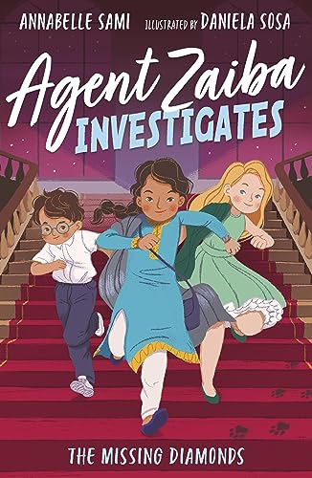
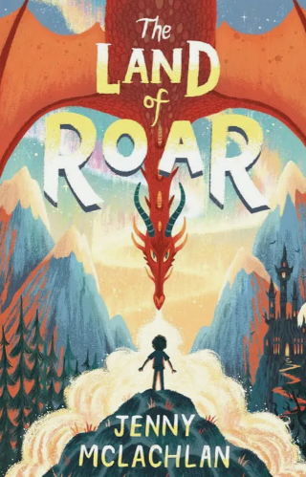
Year 4 Spring Term 1 Class read aloud | Year 4 Spring Term 2 Class read aloud
Anabelle Sami - Agent Saiba Investigates - The Missing Diamonds | Jenny McLachlan - The Land of Roar

Slide 38
NNC YEAR 4 Reading Comprehension Objectives SPRING
 | W1 | W2 | W3 | W4 | W5 | W6 | W1 | W2 | W3 | W4 | W5 | W6
*use dictionaries to check the meaning of words that they have read if they are unsure | x |  |  | x
*increase their familiarity with a wide range of books, including fairy stories, myths and legends | x | x | x |  | x |  | x | x | x | x | x
*Retell some books orally |  |  |  |  | x |  |  |  |  | x
*identify themes in a wide range of books (ie the big messages of a text - e.g. friendship, courage) |  |  | x |  | x |  | x |  |  | x | x
*identify conventions in a wide range of books (ie key features of a particular author or genre) |  |  |  | x |  |  |  |  | x
*prepare poems and play scripts to read aloud and to perform |  | x |  |  |  |  |  | x
*discuss words and phrases that capture the reader’s interest and imagination | x | x |  |  |  |  |  | x
*recognise some different forms of poetry |  | x |  |  |  |  |  | x
*explain the meaning of words in context | x |  |  | x
*draw inferences (such as inferring characters' feelings, thoughts and motives from their actions) and justify inferences with evidence ("I think....because....") | x |  |  |  |  |  | x |  |  | x
*predict what might happen from details stated and implied |  |  | x
*identify main ideas drawn from more than 1 paragraph and summarising these |  |  |  |  |  |  | x
*identify how language contributes to meaning (e.g use of figurative language, precise and visual words) |  |  | x
*identify how structure contributes to meaning (e.g. use of different sentence lengths to build excitement or suspense) |  | x |  | x |  |  | x | x | x |  | x
*identify how presentation contributes to meaning (e.g. certain words written in a different font/bold/italics for emphasis) |  |  |  |  | x |  |  |  |  | x | x
* retrieve and record information from non-fiction |  |  |  | x |  |  |  |  | x

Slide 39
Year 4 Spring Term 1 |  | Year 4 Spring Term 2
Week 1 | Fiction Usborne Illustrated 1001 Arabian Nights (writing unit text) |  | Non-fiction Finding home by Mike Unwin https://www.lovereading4kids.co.uk/extract/23140/Finding-Home-Amazing-Places-Animals-Live-by-Mike-Unwin.html
 | Monday- explain the meaning of words in context Tuesday-identify themes Wednesday-Identify how structure contributes to meaning Thursday-Identify conventions of a wide range of books Friday-discuss words and phrases that capture the reader’s interest and imagination |  | Monday- To explain the meaning of words in context Tuesday-To retrieve and record information from non-fiction Wednesday-To identify how presentation contributes to meaning Thursday-To identify conventions Friday-To identify how language contributes to meaning
Week 2 | Playscript Egyptian Cinderella (History link) https://www.slps.org/cms/lib03/MO01001157/Centricity/Domain/4081/Cinderella--Egypt--Rhodopsis.pdf |  | Fiction Finding bear – Hannah Gold (empathy)
 | Monday-To perform a playscript Tuesday-To identify conventions of play scripts Wednesday-To identify how structure contributes to meaning Thursday-skills Friday- skills |  | Monday-To identify how structure contributes to meaning Tuesday-To identify themes Wednesday-To draw inferences Thursday- skills Friday-skills
Week 3 | Poetry/Fiction - science link What’s The Matter? by Tom McGowen (reading booth) The Rythm of the Rain - Grahame Barker Smith (reading booth) |  | Poetry (reading booth) Life doesn't frighten me at all - Maya Angelou Oh The Places You’ll Go - Dr Seus -
 | Monday - To prepare poems and play scripts to read aloud and to perform Tuesday- To identify themes Wednesday- To recognise some different forms of poetry Thursday-To identify conventions Friday- To draw inferences |  | Monday-prepare poems and play scripts to read aloud and to perform Tuesday-recognise some different forms of poetry Wednesday-identify how structure contributes to meaning Thursday- identify conventions across a range of poems Friday- discuss words and phrases that capture the reader’s interest and imagination
Week 4 | Non-Fiction Atlas of Animal Adventures – Rachel Williams/ Emily Hawkins (writing unit text) |  | Fiction- Little Badman And The Invasion Of The Killer Aunties by Humza Arshad and Henry White (R.E link)
 | Key Los Monday-identify conventions in a wide range of books Tuesday-explain the meaning of words in context Wednesday-retrieve and record information from non-fiction Thursday-skills Friday-skills |  | Monday - To identify how structure contributes to meaning Tuesday- To identify main ideas drawn from more than 1 paragraph and summarising these. Wednesday- To identify how presentation contributes to meaning (e.g. certain words written in a different font/bold/italics for emphasis. Thursday-skills Friday-skills
Week 5 | Non-fiction- National Geographic -1001 Inventions and Awesome Facts From Muslim Civilization (history link) |  | Fiction Agent Asha Mission Shark Bytes - Sophie Deen (reading booth)
 | Monday- To explain the meaning of words in context Tuesday-To retrieve and record information from non-fiction Wednesday-To identify how structure contributes to meaning Thursday-To identify themes in a wide range of books Friday-To identify how language contributes to meaning |  | Monday-identify how structure contributes to meaning Tuesday-predict what might happen from details stated and implied Wednesday-retell orally Thursday-Identify main ideas drawn from more than one paragraph Friday-identify how language contributes to meaning

Slide 40
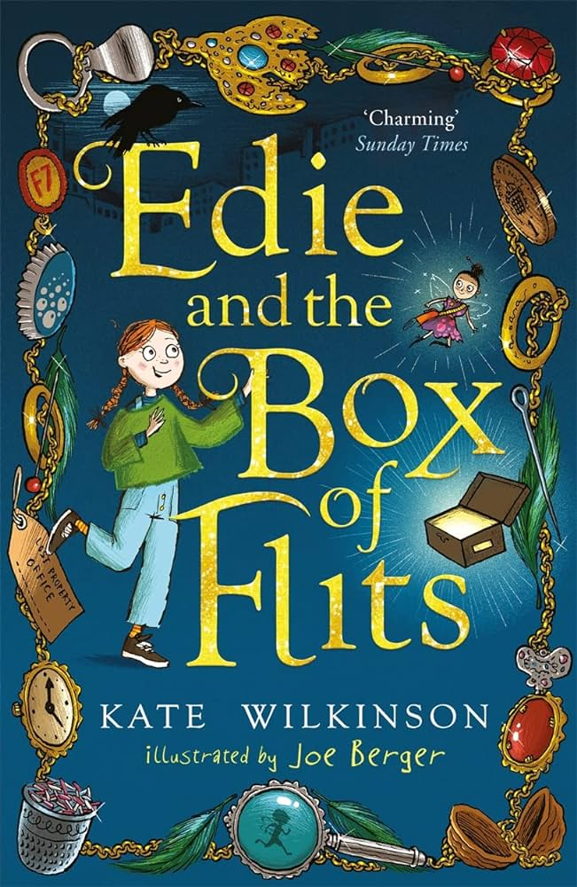
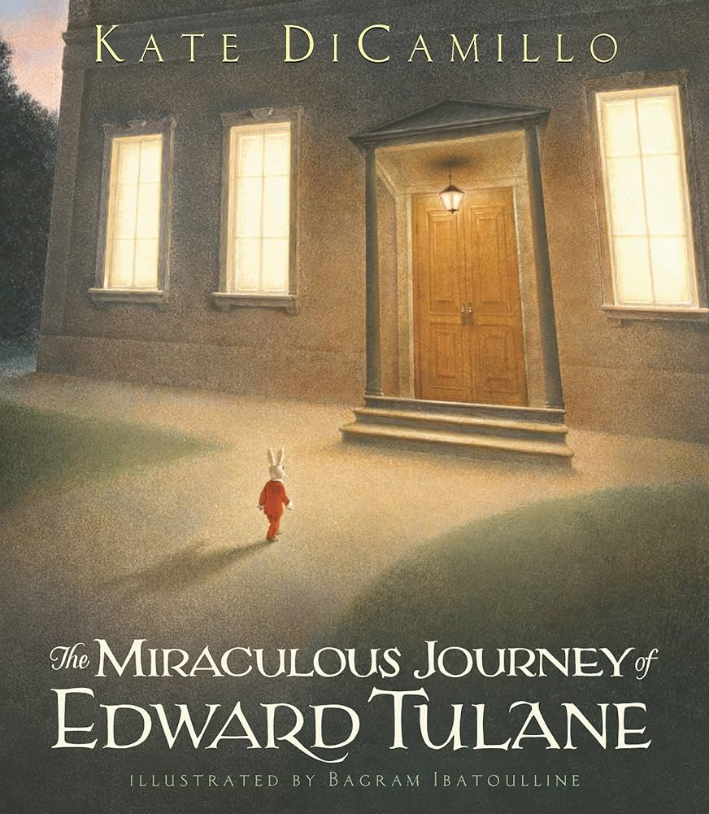
Year 4 Summer Term 1 Class read aloud | Year 4 Summer Term 2 Class read aloud
Kate Wilkinson - Edie and the Box of Flits | Kate DiCamillo - The Miraculous Journey of Edward Tulane

Slide 41
NNC YEAR 4 Reading Comprehension Objectives SUMMER
 | W1 | W2 | W3 | W4 | W5 | W6 | W7 | W1 | W2 | W3 | W4 | W5 | W6 | W7
*use dictionaries to check the meaning of words that they have read if they are unsure |  | x |  |  |  |  |  |  | x |  | x
*increase their familiarity with a wide range of books, including fairy stories, myths and legends | x | x | x | x | x | x |  |  |  | x | x | x | x | x
*Retell some books orally | x |  |  |  |  |  |  |  |  |  |  |  |  | x
*identify themes in a wide range of books (ie the big messages of a text - e.g. friendship, courage) | x |  |  |  |  |  |  | x | x | x
*identify conventions in a wide range of books (ie key features of a particular author or genre) |  | x | x |  |  |  |  |  |  |  | x
*prepare poems and play scripts to read aloud and to perform |  |  |  |  |  | x | x |  |  |  |  | x | x | x
*discuss words and phrases that capture the reader’s interest and imagination |  |  |  |  |  | x | x | x |  |  |  | x | x
*recognise some different forms of poetry |  |  |  |  |  | x | x |  |  |  |  | x | x
*explain the meaning of words in context | x
*draw inferences (such as inferring characters' feelings, thoughts and motives from their actions) and justify inferences with evidence ("I think....because....") |  |  |  | x | x
*predict what might happen from details stated and implied |  |  |  | x | x |  |  |  |  | x
*identify main ideas drawn from more than 1 paragraph and summarising these |  |  |  |  |  |  |  | x | x
*identify how language contributes to meaning (e.g use of figurative language, precise and visual words) |  |  |  | x | x
*identify how structure contributes to meaning (e.g. use of different sentence lengths to build excitement or suspense) |  | x | x | x | x | x | x |  | x |  | x | x | x | x
*identify how presentation contributes to meaning (e.g. certain words written in a different font/bold/italics for emphasis) | x |  |  |  |  |  |  | x | x | x
* retrieve and record information from non-fiction |  | x | x |  |  |  |  |  |  |  | x

Slide 42
Year 4 Summer Term 1 |  | Year 4 Summer Term 2
Week 1 | Poetry Quick! Let’s Get Out of Here – Michael Rosen | Week 1 | Fiction The Hummingbird, My butterfly bouquet, Ride the wind – Nichola Davies (writing unit text)
 | Monday-prepare poems and play scripts to read aloud and to perform Tuesday-recognise some different forms of poetry Wednesday-identify how structure contributes to meaning Thursday- identify conventions across a range of poems Friday- discuss words and phrases that capture the reader’s interest and imagination |  | Key Los Monday-identify how presentation contributes to meaning Tuesday-identify main ideas drawn from more than 1 paragraph and summarising these Wednesday-identify themes in a wide range of books Thursday-identify conventions in a wide range of books Friday-discuss words and phrases that capture the reader’s interest and imagination
Week 2 | Non-Fiction - Science Biography - Thomas Edison – reading booth The History of Electricity – reading Booth | Week 2 | Non –fiction It's her story – Irene Sendler (empathy)
 | Monday-identify conventions in a wide range of books Tuesday-explain the meaning of words in context Wednesday-retrieve and record information from non-fiction Thursday-skills Friday-skills |  | Monday- To explain the meaning of words in context Tuesday-To retrieve and record information from non-fiction Wednesday-To identify how language contributes to meaning Thursday- skills Friday-skills
Week 3 | Fiction The Way of Dog- Zana Fraillon (empathy) | Week 3 | Fiction Pippi Longstocking by Astrid Lindgren – reading booth
 | Monday –To predict what might happen from details stated and implied Tuesday- To identify themes in a wide range of books Wednesday-To identify how structure contributes to meaning Thursday-To identify main ideas drawn from more than 1 paragraph and summarising these Friday- To draw inferences about character feelings |  | Monday-identify how structure contributes to meaning Tuesday-identify themes Wednesday-retell orally Thursday-Identify main ideas drawn from more than one paragraph Friday-identify how language contributes to meaning
Week 4 | Non-Fiction National Geographic: Everything Volcanoes and Earthquakes (Geography link) | Week 4 | Non-Fiction Inventors: Incredible stories of the world's most ingenious inventions – Robert Winston – writing unit text
 | Monday-identify conventions in a wide range of books Tuesday-explain the meaning of words in context Wednesday-retrieve and record information from non-fiction Thursday-skills Friday-skills |  | Monday- To explain the meaning of words in context Tuesday- To identify main ideas drawn from more than 1 paragraph and summarising these Wednesday- To identify conventions Thursday- skills Friday- skills
Week 5 | Fiction How to be more hedgehog - Anne Marie Conway (empathy) | Week 5 | Fiction/Poetry - reading booth It’s A No-Money Day by Kate Milner Brother, Can You Spare A Dime? by Bing Crosby
 | Monday –To predict what might happen from details stated and implied Tuesday- To identify themes in a wide range of books Wednesday-To identify how structure contributes to meaning Thursday-To identify main ideas drawn from more than 1 paragraph and summarising these Friday- To draw inferences about character feelings |  | Monday-prepare poems and play scripts to read aloud and to perform Tuesday-recognise some different forms of poetry Wednesday-identify how structure contributes to meaning Thursday- identify conventions across a range of poems Friday- discuss words and phrases that capture the reader’s interest and imagination
Week 6 | Fiction/ Running on the roof of the world – Jess Butterworth | Week 6 | Fiction- Harry Potter And The Philosopher’s Stone by JK Rowling
 | Monday-identify how presentation contributes to meaning Tuesday-identify main ideas drawn from more than 1 paragraph and summarising these Wednesday-discuss words and phrases that capture the reader’s interest and imagination Thursday- skills Friday- skills |  | Monday- To explain the meaning of words in context Tuesday-To identify themes Wednesday-To identify how structure contributes to meaning Thursday-To identify conventions Friday-To identify how language contributes to meaning
Week 7 | Fiction Bright bursts of Colour – Matt Goodfellow | Week 7 | Poetry (song) (reading booth) A Spoonful of Sugar from Mary Poppins Castle on a Cloud from Les Misérables The Place Where the Lost Things Go from Mary Poppins Returns
 | Monday-identify how structure contributes to meaning Tuesday-predict what might happen from details stated and implied Wednesday-retell orally Thursday-Identify main ideas drawn from more than one paragraph Friday-identify how language contributes to meaning |  | Monday - To prepare poems and play scripts to read aloud and to perform Tuesday- To identify themes Wednesday- To recognise some different forms of poetry Thursday-skills Friday - skills

Slide 43
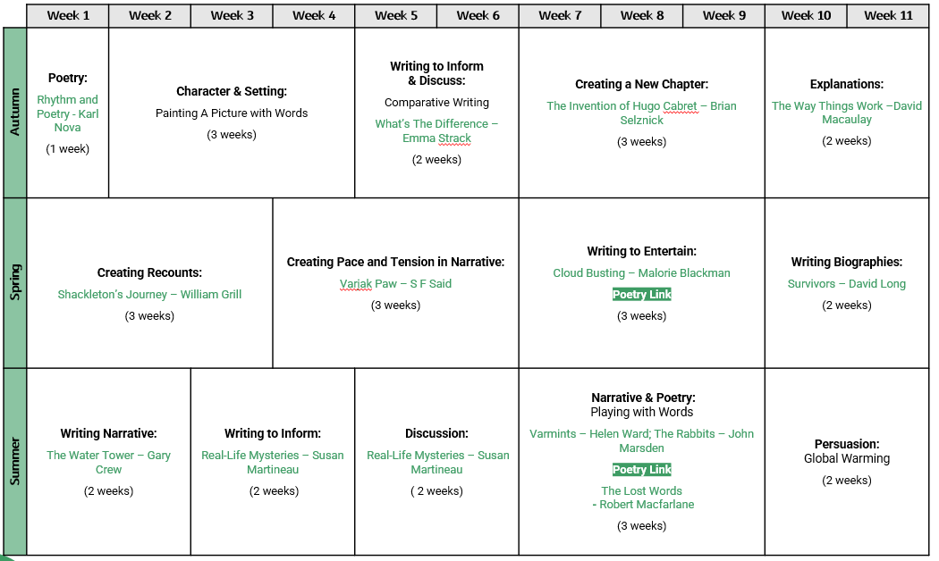
Year 5 writing unit and text overview

Slide 44
Year 5 Autumn Term 1 Class read aloud | Year 5 Autumn Term 2 Class read aloud
Malorie Blackman – A dangerous game | Katherine Rundell - The Wolf Wilder

Slide 45
Weekly reading structure
Year 5
Monday | Tuesday | Wednesday | Thursday | Friday
Vocabulary instruction (10 minutes daily – 365 words and etymology)
Extended reading (30 mins) | Close reading (30 mins) | Fluency (30 mins) | Extended reading (30 mins) | Close reading (30 mins)
Monday | Tuesday | Wednesday | Thursday | Friday
Vocabulary instruction (10 minutes daily – 365 words and etymology)
Extended reading (30 mins) | Close reading (30 mins) | Fluency (30 mins) | Skills (30 mins) | Skills (30 mins)

Slide 46
Year 5 Autumn Term 1 |  | Year 5 Autumn Term 2
Week 1 | Poetry Text - Karl Nova (writing) | Week 1 | Fiction - The Inventions of Hugo Cabaret (writing unit text)
 | Monday-Identify themes and conventions Tuesday-discuss and evaluate how authors use language, including figurative language, considering the impact on the reader Wednesday-learn a wider range of poetry by heart Thursday-make comparisons between poems Friday- Identify how language contributes to meaning |  | Monday--Identify themes and conventions Tuesday-discuss and evaluate how authors use language, including figurative language, considering the impact on the reader Wednesday-Identify how presentation contributes to meaning Thursday-skills Friday-skills
Week 2 | Fiction–City of Stolen Magic Nazneen Ahmed Pathak (empathy lab) | Week 2 | Poetry - Michael Rosen – Everyone comes from somewhere
 | Monday –To predict what might happen from details stated and implied Tuesday- To identify themes in a wide range of books Wednesday-To identify how structure contributes to meaning Thursday-skills Friday- skills |  | Monday-Identify themes and conventions Tuesday-discuss and evaluate how authors use language, including figurative language, considering the impact on the reader Wednesday-learn a wider range of poetry by heart Thursday-make comparisons between poems Friday- Identify how language contributes to meaning
Week 3 | Fiction – The Clockwork Crow ( reading booth) | Week 3 | Fiction - My life on fire – Cath Howe (empathy)
 | Monday-Discuss understanding, explore the meanings of words in context Tuesday-draw inferences such as inferring characters' feelings, thoughts and motives from their actions Wednesday-identify how language, structure and presentation contribute to meaning Thursday-predict what might happen from details stated and implied Friday-discuss and evaluate how authors use language, including figurative language, considering the impact on the reader |  | Monday-identify themes and conventions Tuesday-draw inferences such as inferring characters' feelings, thoughts and motives from their actions Wednesday-identify how language, structure and presentation contribute to meaning Thursday-skills Friday-skills
Week 4 | Non-fiction- The Romans, gods, emperors and dormice – by Marcia Williams (history link) | Week 4 | Non-fiction -The way things work - David Mcauley
 | Monday-Retrieve and record information from non-fiction Tuesday-Provide justified reasoning for their views Wednesday-Explore the meanings of words in context Thursday-skills Friday-skills |  | Monday-Provide justified reasoning for views Tuesday-Distinguish between fact and opinion Wednesday-identify how presentation contributes to meaning Thursday-explain and discuss their understanding of what they have read, including through formal presentations and debates Friday-Explain meaning of words in context
Week 5 | Fiction – Peter Pan | Week 5 | Fiction - The Orchard Book of Roman Myths
 | Monday-summarise the main ideas drawn from more than 1 paragraph, identifying key details that support the main ideas Tuesday-discuss and evaluate how authors use language, including figurative language, considering the impact on the reader Wednesday-identify how language, structure and presentation contribute to meaning Thursday-identify and discuss themes and conventions Friday-draw inferences such as inferring characters' feelings, thoughts and motives from their actions, and justifying inferences with evidence |  | Monday-summarise the main ideas drawn from more than 1 paragraph, identifying key details that support the main ideas Tuesday-discuss and evaluate how authors use language, including figurative language, considering the impact on the reader Wednesday-identify how language, structure and presentation contribute to meaning Thursday-identify and discuss themes and conventions Friday-draw inferences such as inferring characters' feelings, thoughts and motives from their actions, and justifying inferences with evidence
Week 6 | Non-fiction - What's the difference? - non-fiction (Writing text) | Week 6 | Poetry - We Refugees by Benjamin Zephaniah Do Not Stand At My Grave And Weep by Mary Elizabeth Frye (reading booth)
 | Monday--explain and discuss their understanding of what they have read, including through formal presentations and debates Tuesday-Retrieve and record information from non-fiction Wednesday-identify how presentation contributes to meaning Thursday-skills Friday-skills |  | Monday-Identify themes and conventions Tuesday-discuss and evaluate how authors use language, including figurative language, considering the impact on the reader Wednesday-perform poetry Thursday-skills Friday- skills
Week 7 | Non-fiction Marjane Satrapi biography https://kids.kiddle.co/Marjane_Satrapi#:~:text=Filmography-,Biography,monarchy%20of%20the%20last%20Shah. | Week 7 | Non-fiction – How parachutes work How do solar panels work (reading booth-science link)
 | Monday-Provide justified reasoning for views Tuesday-Distinguish between fact and opinion Wednesday-identify how presentation contributes to meaning Thursday-explain and discuss their understanding of what they have read, including through formal presentations and debates Friday-Explain meaning of words in context |  | Monday-Provide justified reasoning for views Tuesday-Distinguish between fact and opinion Wednesday-identify how presentation contributes to meaning Thursday-explain and discuss their understanding of what they have read, including through formal presentations and debates Friday-Explain meaning of words in context
Week 8 | Fiction - Kofi and the rap battle summer (empathy)
 | Monday-summarise the main ideas drawn from more than 1 paragraph, identifying key details that support the main ideas Tuesday-discuss and evaluate how authors use language, including figurative language, considering the impact on the reader Wednesday-identify how language, structure and presentation contribute to meaning Thursday-skills Friday-skills

Slide 47
NNC Year 5 Reading Comprehension Objectives AUTUMN
 | W1 | W2 | W3 | W4 | W5 | W6 | W7 | W8* | W9 | W10 | W11 | W12
*increase their familiarity with a wide range of books, including myths, legends and traditional stories, modern fiction, fiction from our literary heritage, and books from other cultures and traditions – extended over a longer period | x | x | x | x | x | x | x | x | x | x | x | x
*recommend books that they have read to their peers, giving reasons for their choices – extended reading |  |  |  |  |  |  | x
*identify and discuss themes and conventions in and across a wide range of writing – extended reading | x |  |  |  |  |  | X | X |  | X
*make comparisons within and across books (e.g. between characters, settings, themes, conventions, viewpoints) - extended |  |  | x |  |  |  |  |  |  |  |  | X
*learn a wider range of poetry by heart - fluency | x |  |  |  |  |  |  |  |  |  | X
*prepare poems and plays to read aloud and to perform, showing understanding through intonation, tone and volume so that the meaning is clear to an audience - fluency | x | x |  |  |  |  |  |  | X
*check that the book makes sense to them, discussing their understanding and exploring the meaning of words in context (e.g. trying out synonyms to check meaning) - fluency and close reading |  |  |  | x | x |  | X F |  |  |  | X
*draw inferences such as inferring characters' feelings, thoughts and motives from their actions, and justifying inferences with evidence ("I think...because in the text....") - close reading |  |  | x |  | x |  | X |  | X
*predict what might happen from details stated and implied – close reading and extended |  |  | x |  | x |  | X | X |  | X
*summarise the main ideas drawn from more than 1 paragraph, identifying key details that support the main ideas (e.g. words and phrases that exemplify the main idea) - extended | x | x |  |  | x | x |  |  |  |  |  | X
*identify how language, structure and presentation contribute to meaning (e.g. how do these give a reader more detail or information? How do they create an effect on the reader?) - fluency |  |  |  |  |  | x |  | X |  | X | X | X
*discuss and evaluate how authors use language, including figurative language, considering the impact on the reader (e.g. what is the author implying to the reader through the use of simile? How do particular words and phrases affect how the reader feels about different characters?) - close |  | x |  |  |  |  |  |  | X | X
*distinguish between statements of fact and opinion close reading |  |  |  | x |  | x |  |  |  |  | X
*retrieve, record and present information from non-fiction extended |  |  |  | x |  | x |  | X |  | X | X | X
*explain and discuss their understanding of what they have read, including through formal presentations and debates, maintaining a focus on the topic and using notes where necessary – extended reading |  |  |  | x |  |  |  |  | X | X
*provide reasoned justifications for their views – close reading | x | x |  |  |  |  |  | X

Slide 48
Year 5 Spring Term 1 Class read aloud | Year 5 Spring Term 2 Class read aloud
Onjali Rauf - The Day we met the Queen | Charlie Higson - Silverfin

Slide 49
Year 5 Spring Term 1 |  | Year 5 Spring Term 2
Week 1 | Non-fiction Shackleton's journey (writing unit text) | Week 1 | Poetry - Cloud Busting – Malorie Blackman (writing unit text)
 | Monday-Summarise from more than 1 paragraph Tuesday-Explain the meaning of words in context Wednesday-identify how presentation contributes to meaning Thursday-explain and discuss their understanding of what they have read, including through formal presentations and debates Friday-Explain meaning of words in context |  | Monday-Identify themes and conventions Tuesday-discuss and evaluate how authors use language, including figurative language, considering the impact on the reader Wednesday-learn a wider range of poetry by heart Thursday-make comparisons between poems Friday- Identify how language contributes to meaning
Week 2 | Non-fiction - Life cycles (reading booth-science link) | Week 2 | Fiction - The explorer by Katherine Rundell (reading booth)
 | Monday-Provide justified reasoning for views Tuesday-Distinguish between fact and opinion Wednesday-identify how presentation contributes to meaning Thursday-skills Friday-skills |  | Monday-identify themes and conventions Tuesday-draw inferences such as inferring characters' feelings, thoughts and motives from their actions Wednesday-identify how language, structure and presentation contribute to meaning Thursday-skills Friday-skills
Week 3 | Fiction - Until the Road Ends- Phil Earle (empathy lab) | Week 3 | Fiction - Cogheart by Peter Bunzl (reading booth)
 | Monday-identify themes and conventions Tuesday-draw inferences such as inferring characters' feelings, thoughts and motives from their actions Wednesday-identify how language, structure and presentation contribute to meaning Thursday-predict what might happen from details stated and implied Friday-discuss and evaluate how authors use language, including figurative language, considering the impact on the reader |  | Monday-summarise the main ideas drawn from more than 1 paragraph, identifying key details that support the main ideas Tuesday-discuss and evaluate how authors use language, including figurative language, considering the impact on the reader Wednesday-identify how language, structure and presentation contribute to meaning Thursday-identify and discuss themes and conventions Friday-draw inferences such as inferring characters' feelings, thoughts and motives from their actions, and justifying inferences with evidence
Week 4 | Fiction - Varjak Paw (writing unit text) | Week 4 | Non-fiction - Survivors – David Long (writing unit text)
 | Monday-summarise the main ideas drawn from more than 1 paragraph, identifying key details that support the main ideas Tuesday-discuss and evaluate how authors use language, including figurative language, considering the impact on the reader Wednesday-identify how language, structure and presentation contribute to meaning Thursday-skills Friday-skills |  | Monday-Summarise from more than 1 paragraph Tuesday-Explain the meaning of words in context Wednesday-identify how structure contributes to meaning Thursday-skills Friday-skills
Week 5 | Poetry- The Listeners by Walter De La Mere (reading booth) | Week 5 | Poetry - Where Is The Love? by The Black Eyed Peas, Piece By Piece by Kelly Clarkson (reading booth)
 | Monday-Identify themes and conventions Tuesday-discuss and evaluate how authors use language, including figurative language, considering the impact on the reader Wednesday-learn a wider range of poetry by heart Thursday-make comparisons between poems Friday- Identify how language contributes to meaning |  | Monday-Identify themes and conventions Tuesday-discuss and evaluate how authors use language, including figurative language, considering the impact on the reader Wednesday-learn a wider range of poetry by heart Thursday-make comparisons between poems Friday- Identify how language contributes to meaning

Slide 50
NNC Year 5 Reading Comprehension Objectives SPRING
 | W1 | W2 | W3 | W4 | W5 | W6 | W7 | W8 | W9 | W10 | W11 | W12
*increase their familiarity with a wide range of books, including myths, legends and traditional stories, modern fiction, fiction from our literary heritage, and books from other cultures and traditions
*recommend books that they have read to their peers, giving reasons for their choices
*identify and discuss themes and conventions in and across a wide range of writing |  |  | X |  |  |  |  | X |  | X
*make comparisons within and across books (e.g between characters, settings, themes, conventions, viewpoints) |  |  |  | X |  |  | X |  | X
*learn a wider range of poetry by heart |  |  |  |  | X
*prepare poems and plays to read aloud and to perform, showing understanding through intonation, tone and volume so that the meaning is clear to an audience |  |  |  |  |  | X
*check that the book makes sense to them, discussing their understanding and exploring the meaning of words in context (e.g. trying out synonyms to check meaning) | X | X | X |  |  |  | X | X
*draw inferences such as inferring characters' feelings, thoughts and motives from their actions, and justifying inferences with evidence ("I think...because in the text....") |  |  | X | X |  |  | X | X
*predict what might happen from details stated and implied |  |  | X | X |  |  |  | X
*summarise the main ideas drawn from more than 1 paragraph, identifying key details that support the main ideas (e.g. words and phrases that exemplify the main idea) | X |  |  |  | X
*identify how language, structure and presentation contribute to meaning (e.g. how do these give a reader more detail or information? How do they create an effect on the reader?) | X |  |  | X |  |  |  |  | X
*discuss and evaluate how authors use language, including figurative language, considering the impact on the reader (e.g. what is the author implying to the reader through the use of simile? How do particular words and phrases affect how the reader feels about different characters?) |  |  |  |  | X | X | X
*distinguish between statements of fact and opinion |  | X
*retrieve, record and present information from non-fiction |  | X |  |  |  |  |  |  | X
*explain and discuss their understanding of what they have read, including through formal presentations and debates, maintaining a focus on the topic and using notes where necessary |  | X |  |  | X | X
*provide reasoned justifications for their views. | X |  |  |  |  |  |  |  |  | X

Slide 51
Year 5 Summer Term 1 Class read aloud | Year 5 Summer Term 2 Class read aloud
Maz Evans – Simply the Quest | Thomas Taylor - Malamander

Slide 52
Year 5 Summer Term 1 |  | Year 5 Summer Term 2
Week 1 | Fiction – Fablehouse E.L Norry (empathy) | Week 1 | Poetry - The Walrus and the Carpenter by Lewis Carroll
 | Monday-identify themes and conventions Tuesday-draw inferences such as inferring characters' feelings, thoughts and motives from their actions Wednesday-identify how language, structure and presentation contribute to meaning Thursday-predict what might happen from details stated and implied Friday-discuss and evaluate how authors use language, including figurative language, considering the impact on the reader |  | Monday-Identify themes and conventions Tuesday-discuss and evaluate how authors use language, including figurative language, considering the impact on the reader Wednesday-learn a wider range of poetry by heart Thursday-make comparisons between poems Friday- Identify how language contributes to meaning
Week 2 | Poetry- The Highway Man – Alfred (reading booth) | Week 2 | Fiction - The Island At The End Of Everything by Kiran Millwood Hargrave (reading booth)
 | Monday-Identify themes and conventions Tuesday-discuss and evaluate how authors use language, including figurative language, considering the impact on the reader Wednesday-learn a wider range of poetry by heart Thursday-skills Friday- skills |  | Monday-identify themes and conventions Tuesday-draw inferences such as inferring characters' feelings, thoughts and motives from their actions Wednesday-identify how language, structure and presentation contribute to meaning Thursday-skills Friday-skills
Week 3 | Non-fiction - Real Life Mysteries – Susan Martineua (writing unit text) | Week 3 | Fiction - Global - Eoin Colfer & Andrew Donkin (empathy)
 | Monday-Summarise from more than 1 paragraph Tuesday-Explain the meaning of words in context Wednesday-identify how presentation contributes to meaning Thursday-explain and discuss their understanding of what they have read, including through formal presentations and debates Friday-Explain meaning of words in context |  | Monday-Provide justified reasoning for views Tuesday-draw inferences such as inferring characters' feelings, thoughts and motives from their actions Wednesday-identify how language, structure and presentation contribute to meaning Thursday-summarise ideas from more than 1 paragraph Friday-discuss and evaluate how authors use language, including figurative language, considering the impact on the reader
Week 4 | Non – fiction- Mae Jemison (reading booth) | Week 4 | Fiction: The Fantastic Flying Books Of Mr Morris Lessmore by WE Joyce (reading booth )
 | Monday-Summarise from more than 1 paragraph Tuesday-Explain the meaning of words in context Wednesday-identify how presentation contributes to meaning Thursday-skills Friday-skills |  | Monday-identify themes and conventions Tuesday-draw inferences such as inferring characters' feelings, thoughts and motives from their actions Wednesday-identify how language, structure and presentation contribute to meaning Thursday-skills Friday-skills
Week 5 | Fiction - Finding My Voice Aoife Dooley (empathy) | Week 5 | Non fiction: Margaret Hamilton and Dorothy Vaughan (reading booth - science link)
 | Monday-identify themes and conventions Tuesday-draw inferences such as inferring characters' feelings, thoughts and motives from their actions Wednesday-identify how language, structure and presentation contribute to meaning Thursday-predict what might happen from details stated and implied Friday-discuss and evaluate how authors use language, including figurative language, considering the impact on the reader |  | Monday-Summarise from more than 1 paragraph Tuesday-Explain the meaning of words in context Wednesday-identify how presentation contributes to meaning Thursday-explain and discuss their understanding of what they have read, including through formal presentations and debates Friday-Explain meaning of words in context
Week 6 | Fiction - The Hobbit by JRR Tolkien | Week 6 | Non fiction: Civilisations, yesterday, today (history link)
 | Monday-summarise the main ideas drawn from more than 1 paragraph, identifying key details that support the main ideas Tuesday-discuss and evaluate how authors use language, including figurative language, considering the impact on the reader Wednesday-identify how language, structure and presentation contribute to meaning Thursday-skills Friday-skills |  | Monday-Provide justified reasoning Tuesday-Explain the meaning of words in context Wednesday-identify how presentation, language and structure contributes to meaning Thursday-explain and discuss their understanding of what they have read, including through formal presentations and debates Friday-Explain meaning of words in context

Slide 53
NNC Year 5 Reading Comprehension Objectives SUMMER
 | W1 | W2 | W3 | W4 | W5 | W6 | W7 | W8 | W9 | W10 | W11 | W12
*increase their familiarity with a wide range of books, including myths, legends and traditional stories, modern fiction, fiction from our literary heritage, and books from other cultures and traditions | X | X | X | X | X | X | X | X | X | X | X | X
*recommend books that they have read to their peers, giving reasons for their choices | X | X | X | X | X | X | X | X | X | X | X | X
*identify and discuss themes and conventions in and across a wide range of writing |  |  |  | X |  |  | X | X |  |  |  | X
*make comparisons within and across books (e.g between characters, settings, themes, conventions, viewpoints) | X |  |  |  |  |  | X
*learn a wider range of poetry by heart |  | X |  |  |  |  | X
*prepare poems and plays to read aloud and to perform, showing understanding through intonation, tone and volume so that the meaning is clear to an audience |  | X |  |  |  |  | X
*check that the book makes sense to them, discussing their understanding and exploring the meaning of words in context (e.g. trying out synonyms to check meaning) | X |  |  | X | X | X |  | X | X | X |  | X
*draw inferences such as inferring characters' feelings, thoughts and motives from their actions, and justifying inferences with evidence ("I think...because in the text....") |  | X |  | X
*predict what might happen from details stated and implied |  |  |  | X |  | X |  | X |  |  |  | X
*summarise the main ideas drawn from more than 1 paragraph, identifying key details that support the main ideas (e.g. words and phrases that exemplify the main idea) | X |  |  |  | X |  |  |  |  | X
*identify how language, structure and presentation contribute to meaning (e.g. how do these give a reader more detail or information? How do they create an effect on the reader?) |  |  | X |  |  |  |  |  | X
*discuss and evaluate how authors use language, including figurative language, considering the impact on the reader (e.g. what is the author implying to the reader through the use of simile? How do particular words and phrases affect how the reader feels about different characters?) |  | X |  |  | X | X | X |  |  |  |  | X
*distinguish between statements of fact and opinion |  |  | X |  |  |  |  |  |  |  | X
*retrieve, record and present information from non-fiction |  |  | X |  | X |  |  |  | X | X | X
*explain and discuss their understanding of what they have read, including through formal presentations and debates, maintaining a focus on the topic and using notes where necessary |  |  | X |  |  |  |  |  | X | X | X
*provide reasoned justifications for their views. | X |  |  |  |  | X

Slide 54
Year 6 writing unit and text overview
 | Week 1 | Week 2 | Week 3 | Week 4 | Week 5 | Week 6 | Week 7 | Week 8 | Week 9 | Week 10 | Week 11
Autumn | Poetry: Poetry Please: The Seasons – Various; If All The World Were – J Coelho (1 week) | Creating Narrative: Quest How To Train Your Dragon – Cressida Cowell (2 weeks) |  | Informative Writing: Experimenting with Formality & Voice Fantastic Beasts and Where to Find Them – JK Rowling (3 weeks) |  |  | Creating a New Chapter: SeaBEAN – Sarah Holding (3 weeks) |  |  | Persuasion: Reducing Waste Campaign (2 weeks)
Spring | Multi-Text Storytelling: The Arrival – Shaun Tan Poetry Link ‘On The Move’ - Michael Rosen (4 weeks) |  |  |  | Biographies: Little Leaders - Vashti Harrison (2 weeks) |  | Discussion: What Is Right & Wrong?… - Michael Rosen & Annemarie Young (3 weeks) |  | Narrative Non-fiction: Moth – An Evolution Story/ Fox – A Circle of Life Story – Isabel Thomas (3 weeks) | Narrative Non-fiction: Moth – An Evolution Story/ Fox – A Circle of Life Story – Isabel Thomas (2 weeks)
Summer | Modern Retellings: Shakespeare Mr. William Shakespeare’s Plays - Marcia Williams (3 weeks) |  |  | Journalism: Critical Literacy & Bias (3 weeks) |  |  | Class Anthology: Book of Hopes – Katherine Rundell Poetry Link (3 weeks) |  |  | Fact or Fiction: History’s Mysteries - National Geographic Kids (2 weeks)
Year 6: Autumn

Slide 55
Weekly reading structure
Year 5
Monday | Tuesday | Wednesday | Thursday | Friday
Vocabulary instruction (10 minutes daily – 365 words and etymology)
Extended reading (30 mins) | Close reading (30 mins) | Extended (30 mins) | Extended reading (30 mins) | Close reading (30 mins)
Monday | Tuesday | Wednesday | Thursday | Friday
Vocabulary instruction (10 minutes daily – 365 words and etymology)
Extended reading (30 mins) | Close reading (30 mins) | Extended (30 mins) | Skills (30 mins) | Skills (30 mins)

Slide 56
Year 6 Autumn Term 1 Class read aloud | Year 6 Autumn Term 2 Class read aloud

Slide 57
Year 6 Autumn Term 1 |  | Year 6 Autumn Term 2
Week 1 | The Final Year (verse novel/poetry/empathy lab) | Week 1 | Seabean (fiction)
 | To identify and discuss themes and conventions in and across a wide range of writing To discuss and evaluate how authors use language, including figurative language To identify how language, structure and presentation contribute to meaning To draw inferences |  | To make predictions To summarise the main ideas drawn from more than 1 paragraph, identifying key details that support the main ideas To draw inferences such as inferring characters' feelings, thoughts and motives from their actions, and justifying inferences with evidence ("I think...because in the text....") Skills Skills
Week 2 | How To Train Your Dragon (fiction) | Week 2 | Rooftoppers, The Good Thieves (fiction)
 | To explore the meanings of words in context To infer character motives from their actions and justify To summarise main ideas in more than 1 paragraph To identify how language contributes to meaning To discuss and evaluate how authors use language |  | To predict what might happen from details stated and implied To draw inferences such as inferring characters' feelings, thoughts and motives from their actions, and justifying inferences with evidence To make comparisons within and across books To discuss and evaluate how authors use language, including figurative language, considering the impact on the reader
Week 3 | Treasure Island (fiction) | Week 3 | We Are All Greta, This book is not rubbish (Non-fiction)
 | To make predictions based on details stated and implied To draw inferences about characters To provide reasoned justifications for their views To discuss and evaluate an author's use of language To check that the book makes sense to them, discussing their understanding and exploring the meaning of words in context |  | To retrieve, record and present information from non-fiction To identify and discuss themes and conventions in and across a wide range of writing To distinguish between fact and opinion To explain what they have read through debate To provide reasoned justifications for viewpoints
Week 4 | Fantastic Beasts and Where to Find Them (fiction) | Week 4 | Pompeii and Mount Vesuvius (Non-Fiction)
 | To identify and discuss themes and conventions To check that the book makes sense to them, discussing their understanding and exploring the meaning of words in context (e.g. trying out synonyms to check meaning) To make comparisons between characters To summarise the main ideas drawn from more than 1 paragraph |  | To retrieve, record and present information from non-fiction To distinguish between statements of fact and opinion To make comparisons To summarise the main ideas in more than 1 paragraph To explain and discuss their understanding of what they have read through formal presentations
Week 5 | James Chadwick (Non-fiction) | Week 5 | The Crossover/Other words for home (poetry and fiction)
 | To retrieve, record and present information from non-fiction ​To provide reasoned justifications for their views To distinguish between statements of fact and opinion To explain and discuss their understanding through formal presentations To summarise ideas found in more than one paragraph |  | To discuss themes and conventions To prepare poems and plays to read aloud and to perform, showing understanding through intonation, tone and volume so that the meaning is clear to an audience To increase their familiarity with a wide range of books To discuss and evaluate how an author's choice of language impacts the reader
Week 6 | Civil rights(Rosa Parks, A Change is gon’ come) (non-fiction, poetry) | Week 6 | Charles Darwin (Non-fiction)
 | To provide reasoned justifications for their views. To discuss and evaluate how authors use language, including figurative language, considering the impact on the reader To explain and discuss their understanding of what they have read, including through formal presentations To distinguish between fact and opinion |  | To retrieve, record and present information from non-fiction To provide reasoned justifications for their views To distinguish between statements of fact and opinion To explain and discuss their understanding through formal presentations To summarise ideas found in more than one paragraph
Week 7 | How burglar alarms work (non-fiction) | Week 7 | Sulwe/The Viewer (fiction- picture book)
 | To explore the meanings of words in context To explore how structure supports meaning To summarise ideas from more than 1 pararagraph To retrieve and record information from non-fiction To distinguish between fact and opinion |  | To identify and discuss themes and conventions To identify how presentation contributes to meaning To predict what might happen from details stated and implied To draw inferences To make comparisons between books

Slide 58
NNC Year 6 Reading Comprehension Objectives AUTUMN
 | W1 | W2 | W3 | W4 | W5 | W6 | W7 | W1 | W2 | W3 | W4 | W5 | W6
*increase their familiarity with a wide range of books, including myths, legends and traditional stories, modern fiction, fiction from our literary heritage, and books from other cultures and traditions (extended reading) |  |  | x | x
*recommend books that they have read to their peers, giving reasons for their choices (extended reading)
*identify and discuss themes and conventions in and across a wide range of writing (extended reading) | x |  |  | x |  |  |  |  |  | x |  |  | x
*make comparisons within and across books (e.g between characters, settings, themes, conventions, viewpoints) (extended reading) |  |  |  | x |  |  |  | x | x |  | x |  | x
*learn a wider range of poetry by heart (fluency extended reading) | x
*prepare poems and plays to read aloud and to perform, showing understanding through intonation, tone and volume so that the meaning is clear to an audience (fluency) | x |  |  |  |  | x
*check that the book makes sense to them, discussing their understanding and exploring the meaning of words in context (e.g. trying out synonyms to check meaning) (close reading and extended) |  | x | x | x |  |  | x | x
*draw inferences such as inferring characters' feelings, thoughts and motives from their actions, and justifying inferences with evidence ("I think...because in the text....") (close reading) |  | x | x |  |  |  |  | x | x |  |  |  | x
*predict what might happen from details stated and implied (close and extended) |  |  | x |  |  |  |  | x | x
*summarise the main ideas drawn from more than 1 paragraph, identifying key details that support the main ideas (e.g. words and phrases that exemplify the main idea) (extended) |  | x |  | x | x |  | x | x |  |  |  | x
*identify how language, structure and presentation contribute to meaning (e.g. how do these give a reader more detail or information? How do they create an effect on the reader?) (fluency and close) | x |  |  |  |  |  |  | x |  |  |  |  | x
*discuss and evaluate how authors use language, including figurative language, considering the impact on the reader (e.g. what is the author implying to the reader through the use of simile? How do particular words and phrases affect how the reader feels about different characters?) (close reading) | x | x | x |  |  | x |  |  | x
*distinguish between statements of fact and opinion (close) |  |  |  |  | x | x | x |  |  | x | x | x
*retrieve, record and present information from non-fiction (close and extended) |  |  |  |  | x | x | x |  |  | x | x | x
*explain and discuss their understanding of what they have read, including through formal presentations and debates, maintaining a focus on the topic and using notes where necessary (extended) |  |  |  |  | x | x |  |  |  | x |  | x
*provide reasoned justifications for their views. (extended) |  |  | x |  | x | x |  |  |  | x |  | x

Slide 59
Year 6 Spring Term 1 Class read aloud | Year 6 Spring Term 2 Class read aloud

Slide 60
Year 6 Spring Term 1 |  | Year 6 Spring Term 2
Week 1 | The Arrival (Fiction – picture book) | Week 1 | What is right or wrong? (non-fiction)
 | To increase familiarity with a wide range of books To draw inferences such as inferring characters' feelings, thoughts and motives from their actions, and justifying inferences with evidence To identify and discuss themes and conventions To predict what might happen from details stated and implied To identify how structure and presentation contribute to meaning |  | To check that the book makes sense to them, discussing their understanding and exploring the meaning of words in context To explain and discuss their understanding of what they have read, including through formal presentations and debates, maintaining a focus on the topic and using notes where necessary To summarise To retrieve and record information from non-fiction To provide justification for views
Week 2 | Goodnight Mr Tom (fiction) | Week 2 | Who let the gods out? (fiction)
 | To increase their familiarity with a wide range of books To discuss and evaluate how authors use language, including figurative language, considering the impact on the reader To draw inferences such as inferring characters' feelings, thoughts and motives from their actions, and justifying inferences with evidence To make comparisons within and across books |  | To increase their familiarity with a wide range of books, including myths, legends and traditional stories, modern fiction, fiction from our literary heritage, and books from other cultures and traditions To identify and discuss themes and conventions in and across a wide range of writing To predict from details stated and impled To draw inferences such as inferring characters' feelings, thoughts and motives from their actions, and justifying inferences with evidence To summarise from more than one paragraph
Week 3 | Journeys – the story of migration to Britain Letters from the lighthouse
 | To retrieve from non fiction To justify my reasoning Distinguish between fact and opinion Explain understanding Draw inferences
Week 4 | On the Move (Poetry) | Week 3 | Malamander (fiction)
 | To prepare poems and plays to read aloud and to perform, showing understanding through intonation, tone and volume so that the meaning is clear to an audience To learn a wider range of poetry by heart To identify and discuss themes and conventions in and across a wide range of writing To discuss and evaluate how authors use language, including figurative language, considering the impact on the reader To make comparisons To discuss how language, presentation and structure contribute to meaning |  | To identify how language, structure and presentation contribute to meaning To discuss and evaluate how authors use language, including figurative language, considering the impact on the reader To predict from details stated and implied To summarise from more than one paragraph To discuss themes and conventions
Week 5 | Ibtihaj Mohammad Biography (non-fiction) The Proudest Blue (fiction-picture book) | Week 4 | Moth/Fox (narrative non fiction)
 | To predict from details stated and implied To check that the book makes sense to them, discussing their understanding and exploring the meaning of words in context To draw inferences such as inferring characters' feelings, thoughts and motives from their actions, and justifying inferences with evidence To identify how language, structure and presentation contribute to meaning To summarise the main ideas drawn from more than 1 paragraph, identifying key details that support the main ideas |  | To check that the book makes sense to them, discussing their understanding and exploring the meaning of words in context (e.g. trying out synonyms to check meaning) To identify how language, structure and presentation contribute to meaning (e.g. how do these give a reader more detail or information? How do they create an effect on the reader?) To discuss and evaluate how authors use language, including figurative language, considering the impact on the reader To retrieve, record and present information from non-fiction
Week 6 | On a beam of light(narrative non-fiction) The parts of the eye (non-fiction) | Week 5 | Nevermoore (fiction)
 | To check that the book makes sense to them, discussing their understanding and exploring the meaning of words in context To explain and discuss their understanding of what they have read, including through formal presentations and debates, maintaining a focus on the topic and using notes where necessary To retrieve and record from non-fiction To distinguish between fact and opinion To provide justified reasoning for views |  | To predict what might happen from details stated and implied To draw inferences such as inferring characters' feelings, thoughts and motives from their actions, and justifying inferences with evidence To discuss and evaluate how authors use language, including figurative language, considering the impact on the reader To summarise from more than 1 paragraph

Slide 61
NNC Year 6 Reading Comprehension Objectives SPRING
 | W1 | W2 | W3 | W4 | W5 | W1 | W2 | W3 | W4 | W5
*increase their familiarity with a wide range of books, including myths, legends and traditional stories, modern fiction, fiction from our literary heritage, and books from other cultures and traditions | x | x |  |  |  |  | x
*recommend books that they have read to their peers, giving reasons for their choices
*identify and discuss themes and conventions in and across a wide range of writing | x | x | x |  |  |  | x | x | x
*make comparisons within and across books (e.g between characters, settings, themes, conventions, viewpoints) |  | x | x
*learn a wider range of poetry by heart |  | x | x
*prepare poems and plays to read aloud and to perform, showing understanding through intonation, tone and volume so that the meaning is clear to an audience |  | x | x
*check that the book makes sense to them, discussing their understanding and exploring the meaning of words in context (e.g. trying out synonyms to check meaning) |  |  |  | x | x | x |  |  | x
*draw inferences such as inferring characters' feelings, thoughts and motives from their actions, and justifying inferences with evidence ("I think...because in the text....") |  | x |  | x |  |  | x | x |  | x
*predict what might happen from details stated and implied | x |  |  | x |  |  | x | x |  | x
*summarise the main ideas drawn from more than 1 paragraph, identifying key details that support the main ideas (e.g. words and phrases that exemplify the main idea) | x |  |  | x |  | x | x | x |  | x
*identify how language, structure and presentation contribute to meaning (e.g. how do these give a reader more detail or information? How do they create an effect on the reader?) | x |  | x | x |  |  |  | x | x | x
*discuss and evaluate how authors use language, including figurative language, considering the impact on the reader (e.g. what is the author implying to the reader through the use of simile? How do particular words and phrases affect how the reader feels about different characters?) |  | x | x |  |  |  |  | x | x | x
*distinguish between statements of fact and opinion |  |  |  |  | x | x
*retrieve, record and present information from non-fiction |  |  |  |  | x | x |  |  | x
*explain and discuss their understanding of what they have read, including through formal presentations and debates, maintaining a focus on the topic and using notes where necessary |  |  |  |  | x | x
*provide reasoned justifications for their views. |  |  |  |  | x | x

Slide 62
Year 6 Summer Term 1 Class read aloud | Year 6 Summer Term 2 Class read aloud

Slide 63
Year 6 Summer Term 1 |  | Year 6 Summer Term 2
Week 1 | Macbeth (fiction) | Week 1 | Book of hopes (fiction and poetry)
 | To increase their familiarity with a wide range of books, including myths, legends and traditional stories, modern fiction, fiction from our literary heritage, and books from other cultures and traditions To identify and discuss themes and conventions in and across a wide range of writing To check that the book makes sense to them, discussing their understanding and exploring the meaning of words in context To draw inferences such as inferring characters' feelings, thoughts and motives from their actions, and justifying inferences with evidence To discuss and evaluate how authors use language, including figurative language, considering the impact on the reader. |  | To increase their familiarity with a wide range of books, including myths, legends and traditional stories, modern fiction, fiction from our literary heritage, and books from other cultures and traditions To check that the book makes sense to them, discussing their understanding and exploring the meaning of words in context (e.g. trying out synonyms to check meaning) To draw inferences such as inferring characters' feelings, thoughts and motives from their actions, and justifying inferences with evidence To predict what might happen from details stated and implied To summarise the main ideas drawn from more than 1 paragraph, identifying key details that support the main ideas
Week 2 | Red blood cells/Preventing coronary heart disease (non-fiction) | Week 2 | You are awesome (non-fiction)
 | To distinguish between statements of fact and opinion To identify how language, structure and presentation contribute to meaning To retrieve, record and present information from non-fiction To explain and discuss their understanding of what they have read, including through formal presentations and debates To provide reasoned justifications for their views. |  | To provide justified reasoning for views To distinguish between fact and opinion To discuss how language, presentation and structure contribute to meaning To explain and discuss their understanding of what they have read, including through formal presentations and debates, maintaining a focus on the topic and using notes where necessary
Week 3 | Holes by Louis Sachar (fiction) | Week 3 | Silverfin (fiction)
 | To predict what might happen from details stated and implied To draw inferences such as inferring characters' feelings, thoughts and motives from their actions, and justifying inferences with evidence To summarise the main ideas drawn from more than 1 paragraph, identifying key details that support the main ideas To discuss and evaluate how authors use language, including figurative language, considering the impact on the reader To provide reasoned justifications for their views. |  | To increase their familiarity with a wide range of books, including myths, legends and traditional stories, modern fiction, fiction from our literary heritage, and books from other cultures and traditions To check that the book makes sense to them, discussing their understanding and exploring the meaning of words in context (e.g. trying out synonyms to check meaning) To draw inferences such as inferring characters' feelings, thoughts and motives from their actions, and justifying inferences with evidence To predict what might happen from details stated and implied To summarise the main ideas drawn from more than 1 paragraph, identifying key details that support the main ideas
Week 4 | Representations of Diego Maradona and Mia Hamm Media Representations of Kate Middleton and Meghan Markle (non fiction | Week 4 | Mortal engines (fiction
 | To explain and discuss their understanding of what they have read, including through formal presentations and debates To retrieve, record and present information from non-fiction To summarise the main ideas drawn from more than 1 paragraph, identifying key details that support the main ideas To distinguish between statements of fact and opinion To provide reasoned justifications for their views. |  | To increase their familiarity with a wide range of books, including myths, legends and traditional stories, modern fiction, fiction from our literary heritage, and books from other cultures and traditions To identify and discuss themes and conventions in and across a wide range of writing To check that the book makes sense to them, discussing their understanding and exploring the meaning of words in context To draw inferences such as inferring characters' feelings, thoughts and motives from their actions, and justifying inferences with evidence To discuss and evaluate how authors use language, including figurative language, considering the impact on the reader. To draw inferences To summarise
Week 5 | The True Story Of The Three Little Pigs by Jon Scieszka (fiction) | Week 5 | History's mysteries (non fiction
 | To discuss themes and conventions To explain and discuss their understanding of what they have read, including through formal presentations and debates To identify how language, structure and presentation contribute to meaning To discuss and evaluate how authors use language, including figurative language, considering the impact on the reader To distinguish between statements of fact and opinion |  | To distinguish between statements of fact and opinion To identify how language, structure and presentation contribute to meaning To retrieve, record and present information from non-fiction To explain and discuss their understanding of what they have read, including through formal presentations and debates To provide reasoned justifications for their views.
Week 6 | The risk factors of smoking (non-fiction) | Week 6 | The Raven (poetry)
 | To explain and discuss their understanding of what they have read, including through formal presentations and debates To retrieve, record and present information from non-fiction To summarise the main ideas drawn from more than 1 paragraph, identifying key details that support the main ideas To distinguish between statements of fact and opinion To provide reasoned justifications for their views. |  | To identify and discuss themes and conventions in and across a wide range of writing To learn a wider range of poetry by heart To prepare poems and plays to read aloud and to perform, showing understanding through intonation, tone and volume so that the meaning is clear to an audience To identify how language, structure and presentation contribute to meaning To discuss and evaluate how authors use language, including figurative language, considering the impact on the reader To draw inferences To summarise
Week 7 | Tyger (poetry) | Week 7 | The lost magician (fiction)
 | To identify and discuss themes and conventions in and across a wide range of writing To learn a wider range of poetry by heart To prepare poems and plays to read aloud and to perform, showing understanding through intonation, tone and volume so that the meaning is clear to an audience To identify how language, structure and presentation contribute to meaning To discuss and evaluate how authors use language, including figurative language, considering the impact on the reader |  | To discuss themes and conventions To explain and discuss their understanding of what they have read, including through formal presentations and debates To identify how language, structure and presentation contribute to meaning To discuss and evaluate how authors use language, including figurative language, considering the impact on the reader To draw inferences about a character

Slide 64
NNC Year 6 Reading Comprehension Objectives SUMMER
 | W1 | W2 | W3 | W4 | W5 | W6 | W7 | W1 | W2 | W3 | W4 | W5 | W6
*increase their familiarity with a wide range of books, including myths, legends and traditional stories, modern fiction, fiction from our literary heritage, and books from other cultures and traditions | x |  |  |  |  |  |  | x | x | x | x |  | x
*recommend books that they have read to their peers, giving reasons for their choices
*identify and discuss themes and conventions in and across a wide range of writing | x |  |  |  | x |  | X |  |  | x | x | x
*make comparisons within and across books (e.g between characters, settings, themes, conventions, viewpoints) |  |  |  |  |  |  |  |  |  |  |  |  | x
*learn a wider range of poetry by heart |  |  |  |  |  |  | X
*prepare poems and plays to read aloud and to perform, showing understanding through intonation, tone and volume so that the meaning is clear to an audience |  |  |  |  |  |  | X
*check that the book makes sense to them, discussing their understanding and exploring the meaning of words in context (e.g. trying out synonyms to check meaning) | x |  |  |  |  |  |  | x |  | x | x
*draw inferences such as inferring characters' feelings, thoughts and motives from their actions, and justifying inferences with evidence ("I think...because in the text....") | x |  | x |  |  |  |  | x |  | x | x |  | x
*predict what might happen from details stated and implied |  |  | x |  |  |  |  | x |  | x | x |  | x
*summarise the main ideas drawn from more than 1 paragraph, identifying key details that support the main ideas (e.g. words and phrases that exemplify the main idea) |  |  | x | x |  | x |  | x |  | x | x |  | x
*identify how language, structure and presentation contribute to meaning (e.g. how do these give a reader more detail or information? How do they create an effect on the reader?) |  | x |  |  | x |  | X |  | x |  | x
*discuss and evaluate how authors use language, including figurative language, considering the impact on the reader (e.g. what is the author implying to the reader through the use of simile? How do particular words and phrases affect how the reader feels about different characters?) | x |  | x |  | x |  | X |  |  | x | x |  | x
*distinguish between statements of fact and opinion |  | x |  | x | x | x |  |  | x |  |  | x
*retrieve, record and present information from non-fiction |  | x |  | x |  | x |  |  |  |  |  | x
*explain and discuss their understanding of what they have read, including through formal presentations and debates, maintaining a focus on the topic and using notes where necessary |  | x |  | x | x | x |  |  | x |  |  | x
*provide reasoned justifications for their views. |  | x | x | x |  | x |  |  | x |  |  | x

